Slide 1
Systematic determination of helical parameters of solar magnetic fields from Hinode SOT/SP Level 2 data
K. Otsuji, T. Sakurai, K. Kuzanyan
National Astronomical Observatory of Japan
IZMIRAN, Russian Academy of Sciences, Russia
NAOJ, SSP seminar 2012/06/01

Slide 2
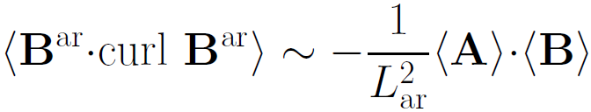

The role of helicity in dynamo
Magnetic helicity
inviscid invariant in MHD
Current helicity
observational proxy of mean magnetic helicity in solar active regions (Zhang et al. 2012)
signature of the alpha-effect (Seehafer 1994)

Slide 3
Plan of the talk
1. Introduction: History of helicity computation
Review of recent studies from Hinode
2.1. Review of available data for active regions,
selection by FOV and strong fields & filling factor (FF)
2.2. Sensitivity & errors: cut-off values, FF,=
examples, cf. ground-based data
2.3. Disambiguation methods. Errors= disambiguation, current errors = examples
3. Helical parameters which we compute
4. Butterfly diagrams of helical parameters
5. Smoothing and altering B_{z}, B_{t} cut-off values for simulating ground-based data.
6. Conclusions

Slide 4
Computation of helicity and the hemispheric rule
Seehafer 1990: 16 active regions (the hemispheric rule: North-/South+ ) for helicity
Pevtsov et al.
1994-1995:
69 ARs

Slide 5
More results on hemispheric rule
Bao & Zhang 1998: 422 ARs
Zhang, Bao, Kuzanyan 2002

Slide 6
More results on hemispheric rule
Hagino & Sakurai 2004-2005
Variation with the solar cycle
also reported by Hagino & Sakurai 2005

Slide 7
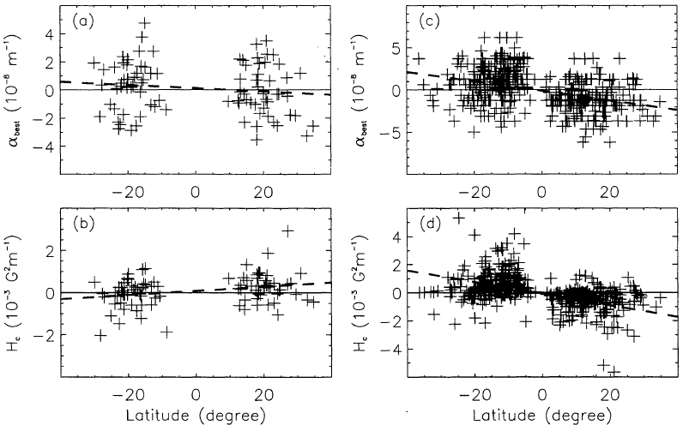
Variations of the hemispheric rule with the solar cycle (Bao et al. 2000)

Slide 8
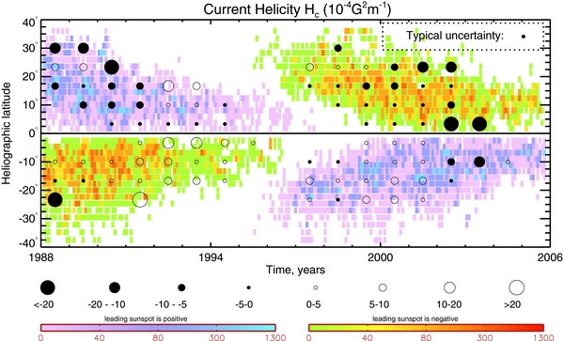
Butterfly diagram for helicity
used 6600+ ARs : Zhang et al. 2010, see also Zhang et al. 2012

Slide 9
Results involving Hinode
Tiwari et al. 2009
Sample of 43 magnetograms: hemispheric sign rule is not confirmed
Hao & Zhang M. 2011
Sample of 64 active region magnetograms from Hinode SOT/SP: most of data for cycle 24 do not follow the hemispheric rule

Slide 10
Purpose of this study
Develop a systematic approach to studies of cyclic variations of helical parameters with Hinode or any other data
Give a statistically significant result on the hemispheric sign rule for helicity over the solar cycle, potentially useful for dynamo theory

Slide 11
Data availability and selection
Hinode SOT SP level2 data
  Available from http://www.csac.hao.ucar.edu/
MERLIN code
  Milne-Eddington gRid Linear Inversion Network
Data period: 2006/11/03-2012/03/18
  total 7430 magnetograms
Data selection criteria
  Near disk center (<30deg)
  FOV>10,000 [arcsec²]
  area(|B|>1kG)>1,000[arcsec²]
  area(FF=0)/FOV < 0.05 (about 90% of overall data)
  Ratio of strong fields=area(|B|>1kG)/FOV~0.1-0.2
  Total amount of data: 864 magnetograms
  Active Regions: 102 ARs

Slide 12
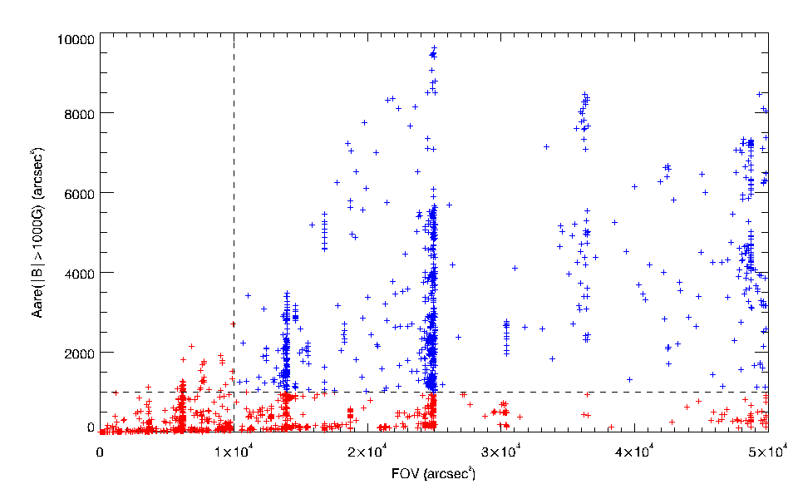
Data filtering
all disk center (<30°) magnetograms: 2630
AR magnetogram: 864
Percentage: 33%

Slide 13
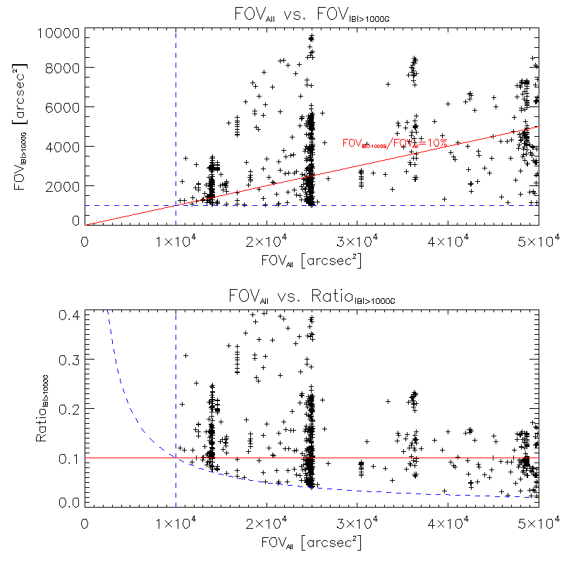
Data filtering
all disk center (<30°) magnetograms: 2630
AR magnetogram: 864
Percentage: 33%

Slide 14
Grouping selected data by time & latitude
Carrington rotation number
Latitude (deg)
Time

Slide 15
Properties of SP level2 data
Pixel size: ~0.3 arcsec for both slit and scan direction for most of magnetograms
Scan duration: 1~2 hours
180°ambiguity: not resolved
Typical noise level
  ~70G for Bx and By (established!)
  ~5G for Bz (established!)

Slide 16
Determination of noise level, assume Gaussian distribution of noise
Distribution of magnetic field
Gaussian fitting of the central part (±Bmax) of histograms for Bx, By and Bz
σ of fitted Gaussian used as the noise level.
-B_{max}
+B_{max}
σ=noise level
0
Bx,By or Bz
[Gauss]
Fitted Gaussian

Slide 17
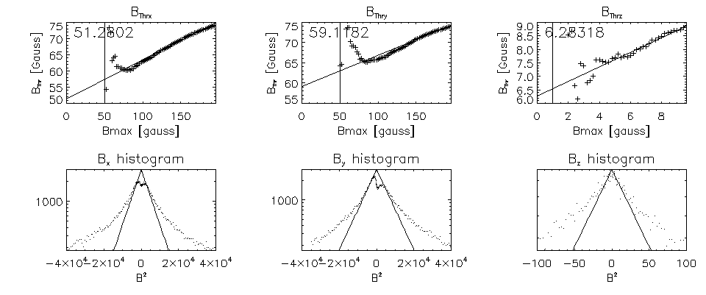
Determination of noise level, assume Gaussian distribution of noise
Determine the noise level by Gaussian fitting of histograms for Bx, By and Bz about the mean value with variable window Bmax.

Slide 18
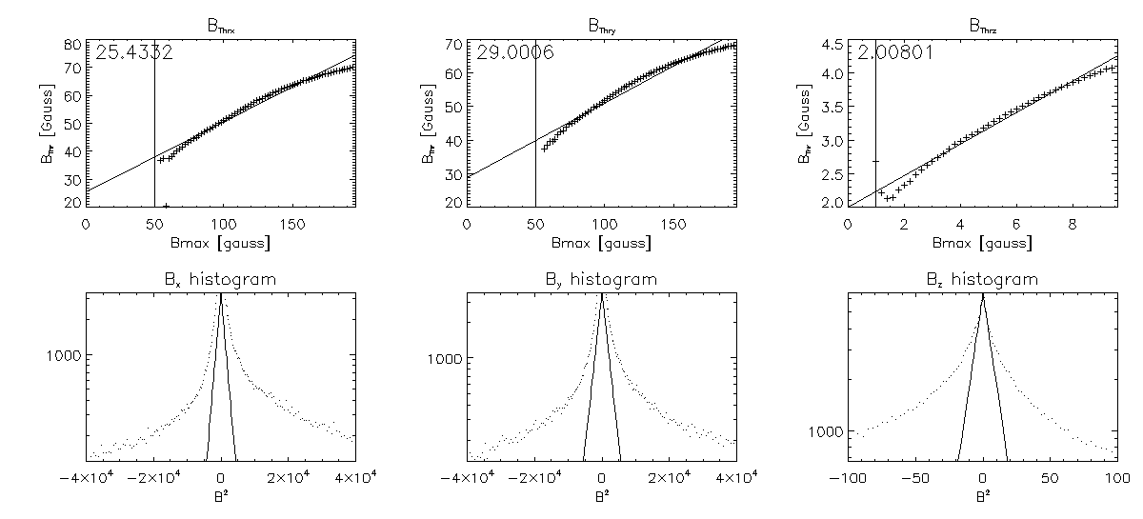
Determination of noise level, assume Gaussian distribution of noise
Determine the noise level by Gaussian fitting of histograms for Bx, By and Bz about the mean value with variable window Bmax.

Slide 19
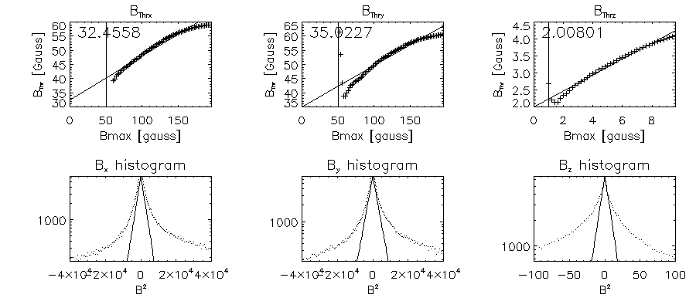
Determination of noise level, assume Gaussian distribution of noise
Revised
Determine the noise level by Gaussian fitting of histograms for Bx, By and Bz about the mean value with variable window Bmax.
Note that the Bx, By and Bz are multiplied by ff^{1/2}, ff^{1/2} and ff, respectivly.

Slide 20
Distributions over magnetic field strength & inclination
70G
example 20061122_150221
(quiet region)
70G
example 20061104_035016 (active region)

Slide 21
Distribution over B_{L} and B_{t} field strength & inclination
example 20061104_035016 (active region)
B_{l}=5G
B_{t}=70G
B_{l}=5G

Slide 22
Resolving 180 degree ambiguity
Disambiguation method
  Combination of potential field approximation (fast) and slower non-potential magnetic field calculation method (NPFC: Georgoulis 2005 – see also Metcalf et al. 2006)
    Weak field (<300G): potential
    Strong field (>300G): NPFC with 1” resolution
    metrics… (cf. Georgoulis 2012)

Slide 23
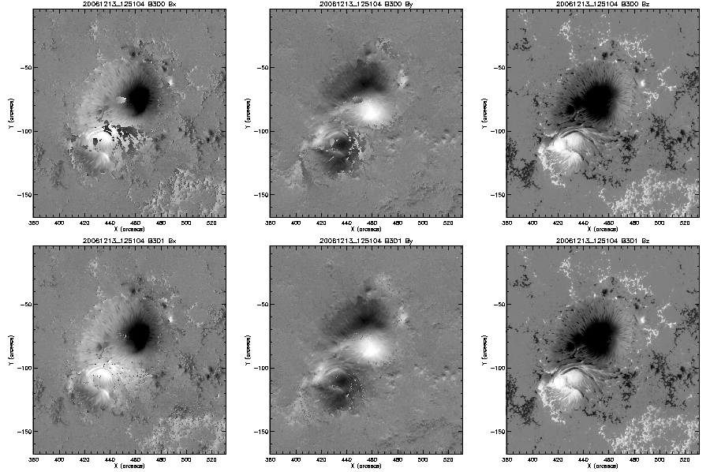
Example of disambiguation
Potential field
approximation only
Potential field+NPFC

Slide 24
Filtering of unreliable pixels
Excluded pixels for calculation
  Inclination angle is almost 0°or 180°
  Filling Factor (magnetic filling fraction)=0
  Erroneously-disambiguated pixels
    By-pixel difference in azimuth: 160°<|Δφ|< 200°
    Spurious derivatives |Curl(B)z|>3×10⁻³ [G/m]
      Corresponding approximately |ΔBx,y|>700G
    Difference between each value of Bx, By
    and its 3-pixel median < 100G

Slide 25
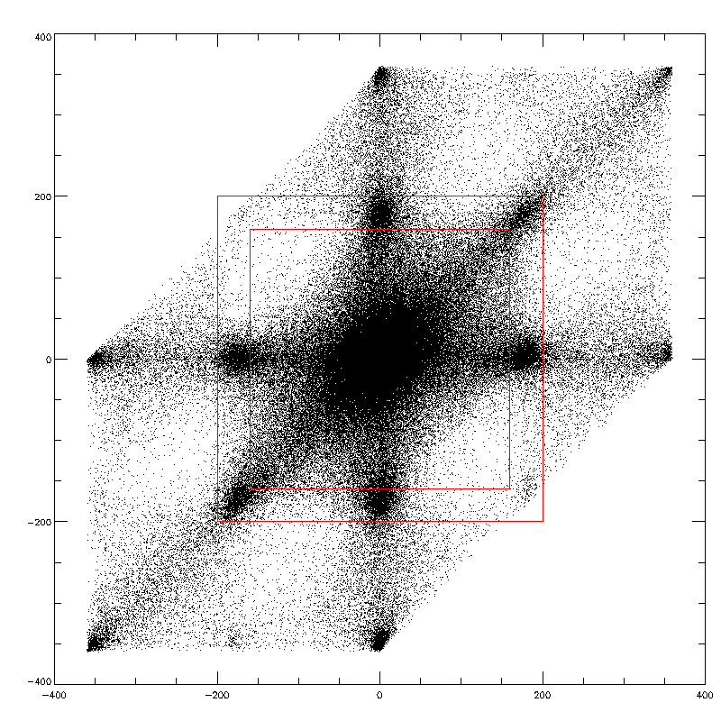
Example of pixel filtering by azimuth by-pixel difference (within the red lines)
dφ/dy
dφ/dx

Slide 26
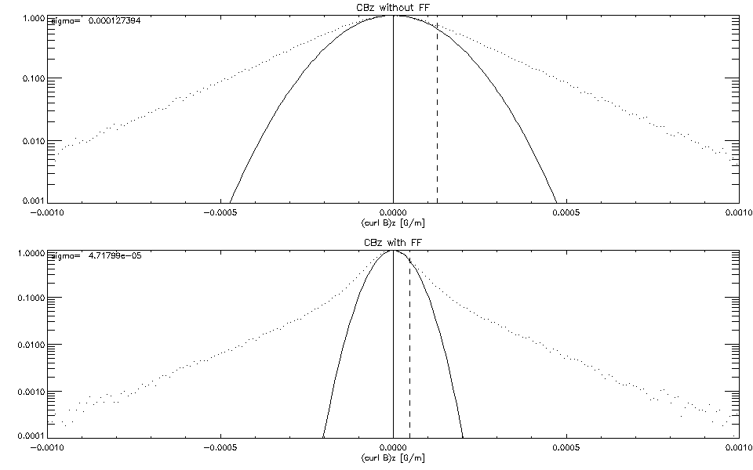
Histogram of (curl B)z
Without and with multiplying filling factor

Slide 27
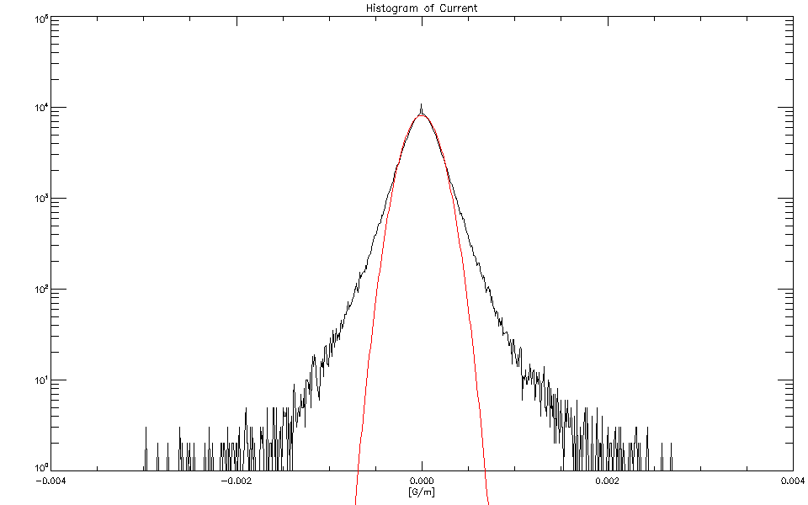
Histogram of (curl B)z
    σ=4×10⁻⁴ [G/m]

Slide 28
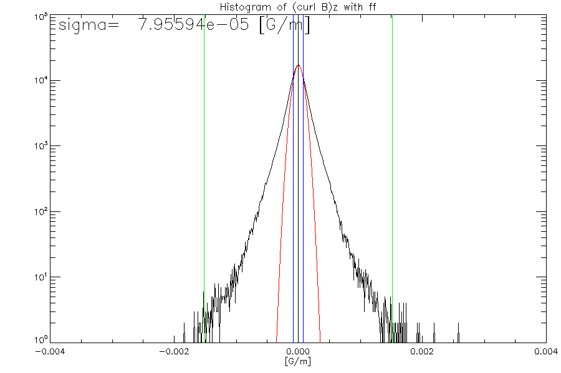
Histogram of (curl B)z
Revised

Slide 29
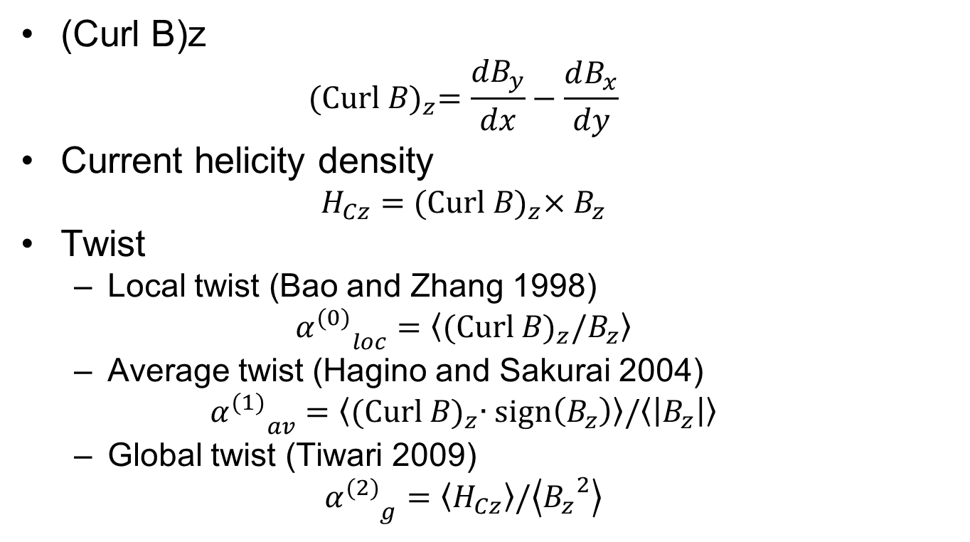
Calculation of Helical Parameters
(Curl B)z
  $${\text{(}\text{Curl} B\text{)}}_{z}=\frac{{dB}_{y}}{dx}−\frac{dB_{x}}{dy}$$
Current helicity density
  $$H_{Cz}={\text{(}\text{Curl} B\text{)}}_{z}×B_{z}$$
Twist
  Local twist (Bao and Zhang 1998)
  $${α_{}^{(0)}}_{loc}=\left\langle {\text{(}\text{Curl} B\text{)}}_{z}/B_{z}\right\rangle$$
  Average twist (Hagino and Sakurai 2004)
  $${α_{}^{(1)}}_{av}=\left\langle {\text{(}\text{Curl} B\text{)}}_{z}∙\text{sign}\left(B_{z}\right)\right\rangle /\left\langle \left|B_{z}\right|\right\rangle$$
  Global twist (Tiwari 2009)
  $${α_{}^{(2)}}_{g}=\left\langle H_{Cz}\right\rangle /\left\langle {B_{z}}^{2}\right\rangle$$

Slide 30
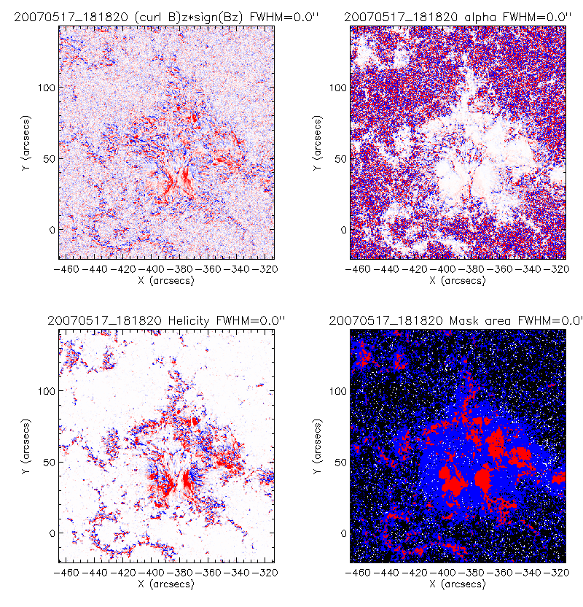
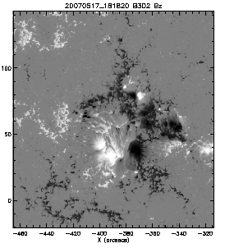
Example maps of distribution of current helicity and local twist without FF (1)
B_{z}
Helicity
Local twist

Slide 31
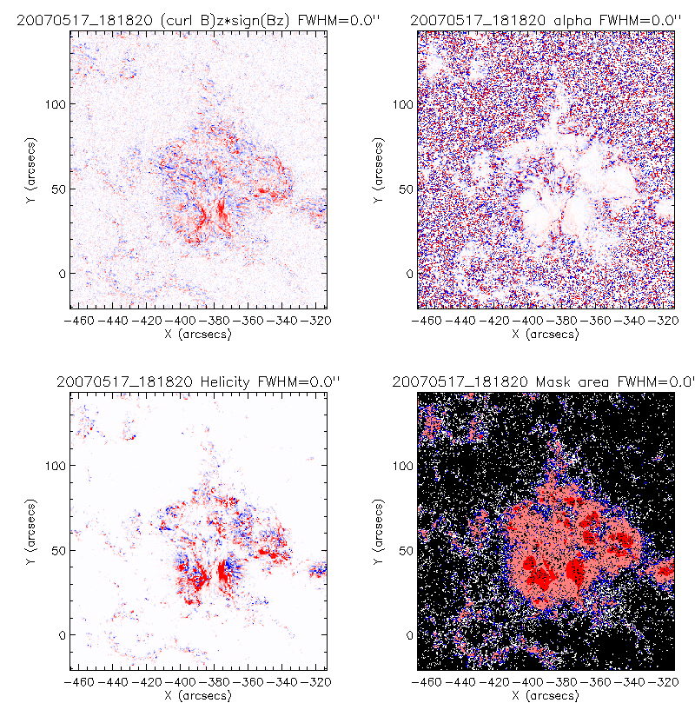
Example maps of distribution of current helicity and local twist with FF (1)
B_{z}
Helicity
Local twist

Slide 32
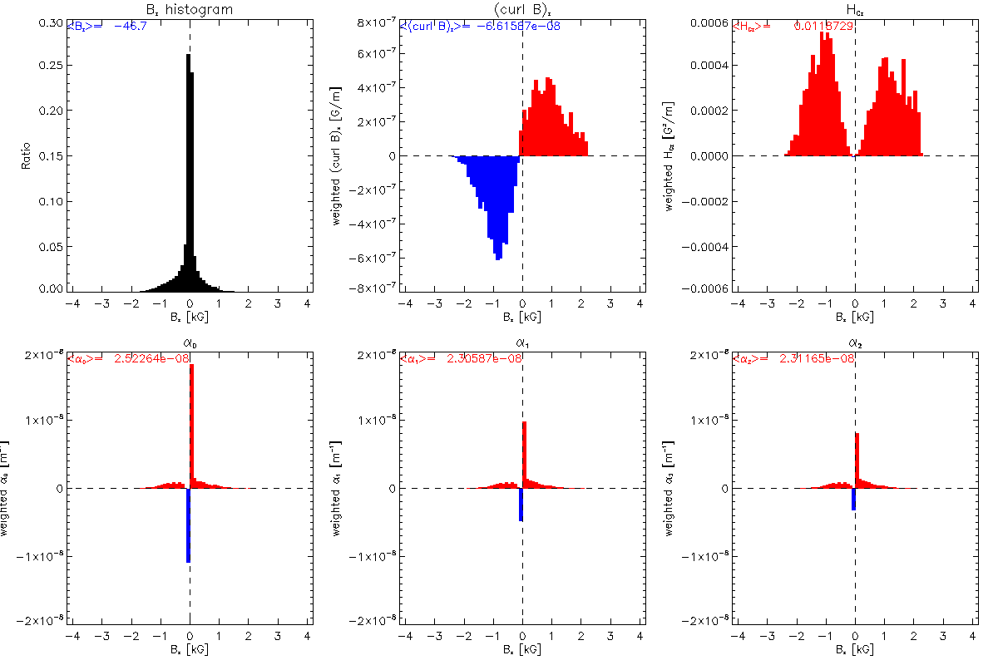
Local distribution of helical parameters over a magnetogram (20070517_181820) without FF
Middle and strong fields contribute to helicity with the same sign.

Slide 33
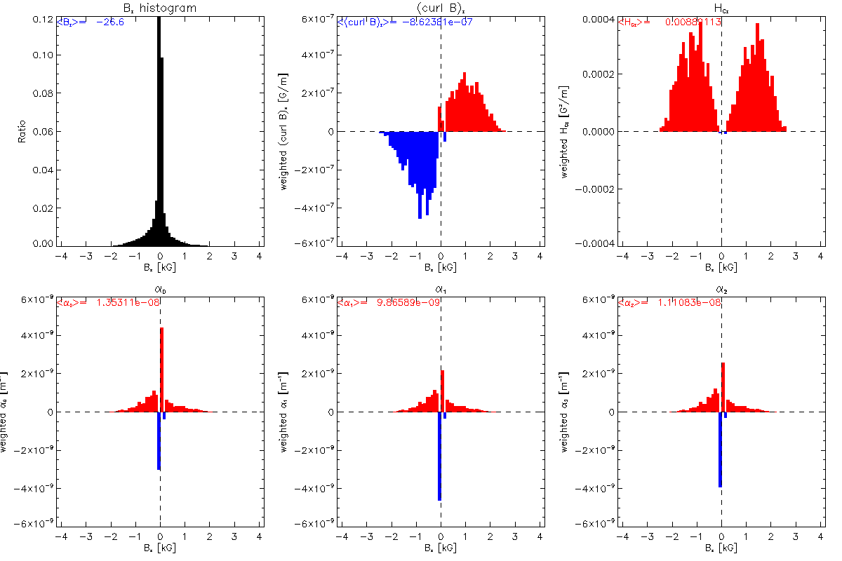
Local distribution of helical parameters over a magnetogram (20070517_181820) with FF
Middle and strong fields contribute to helicity with the same sign.

Slide 34
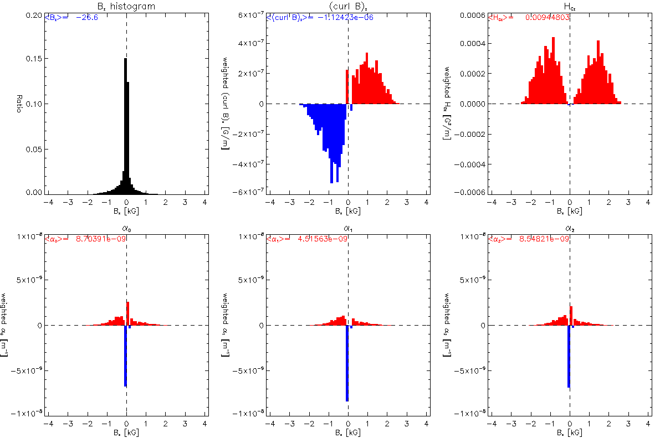
Local distribution of helical parameters over a magnetogram (20070517_181820) with FF
Revised
Middle and strong fields contribute to helicity with the same sign.

Slide 35
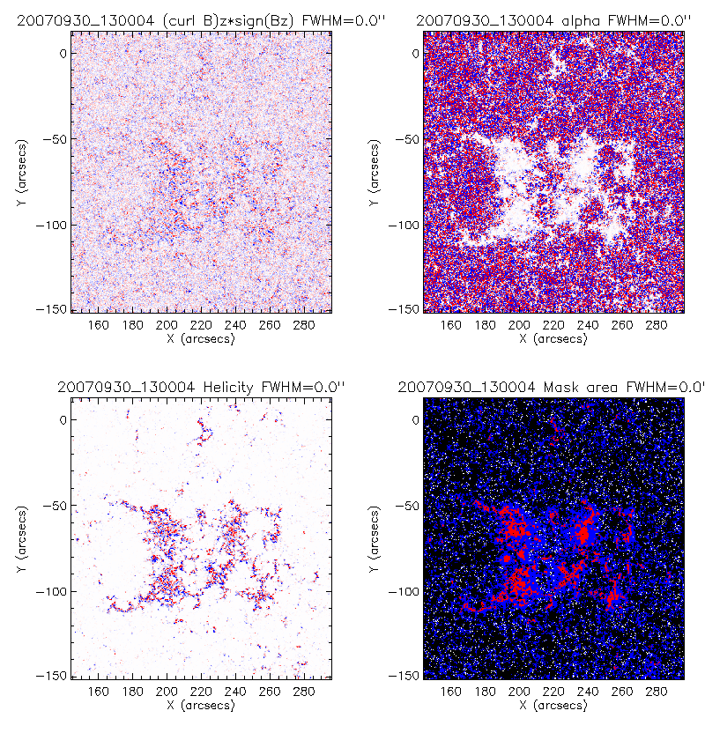
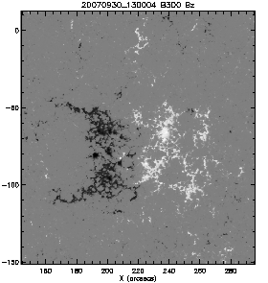
Example maps of distribution of current helicity and local twist without FF (2)
B_{z}
Helicity
Local twist

Slide 36
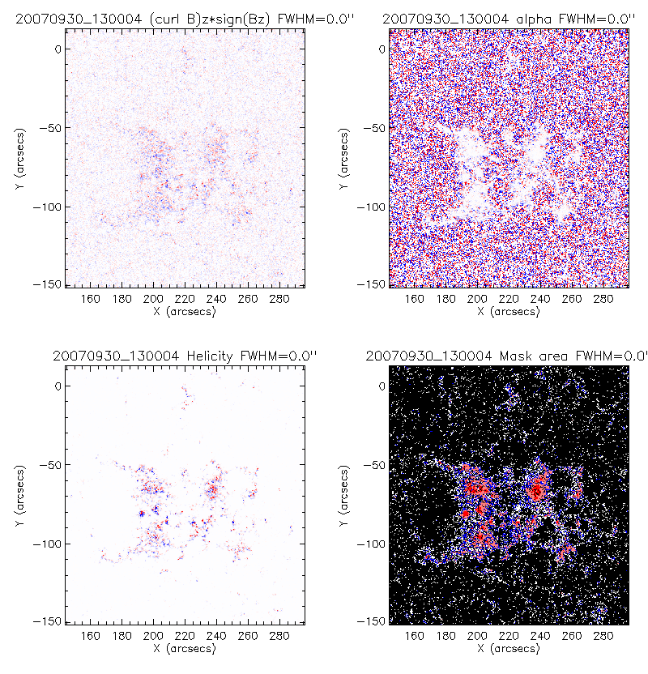
Example maps of distribution of current helicity and local twist with FF (2)
B_{z}
Helicity
Local twist

Slide 37
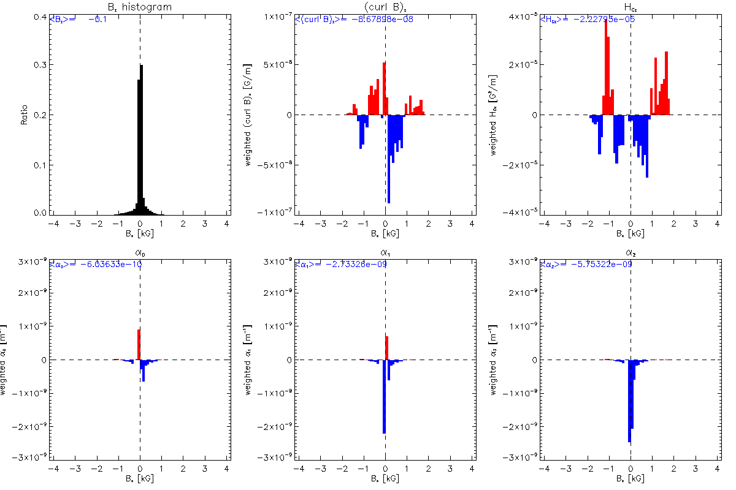
Local distribution of helical parameters over a magnetogram (20070930_130004) without FF
Middle and strong fields contribute to helicity with opposite signs.

Slide 38
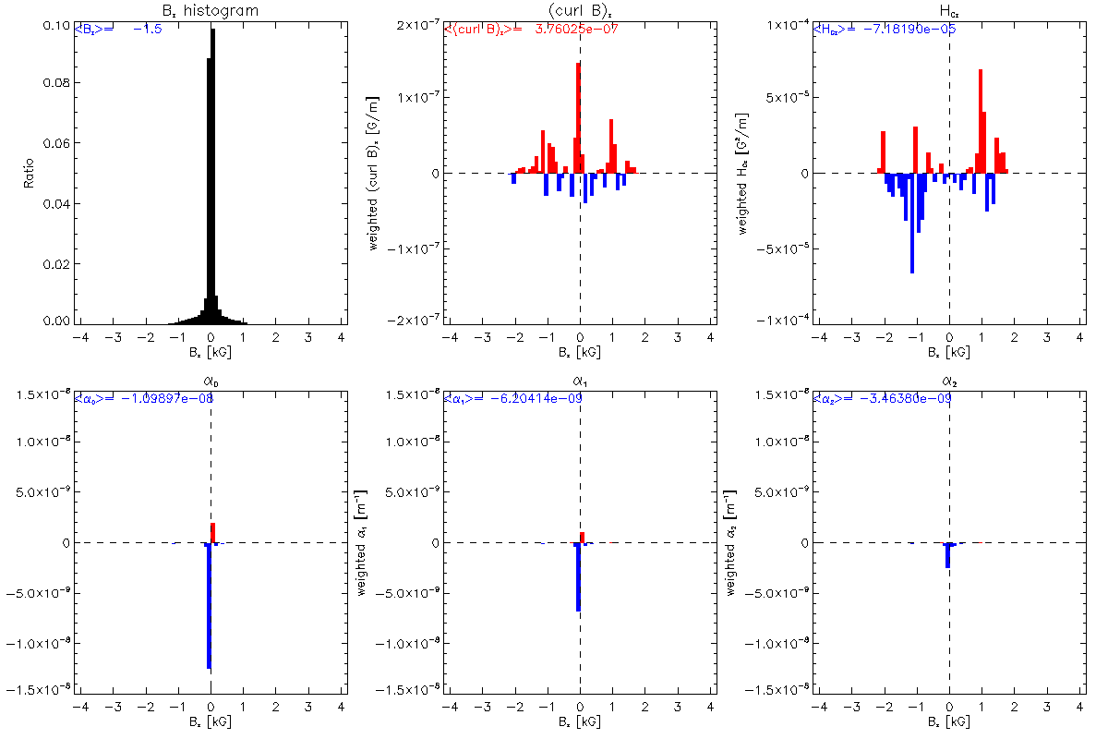
Local distribution of helical parameters over a magnetogram (20070930_130004) with FF

Slide 39
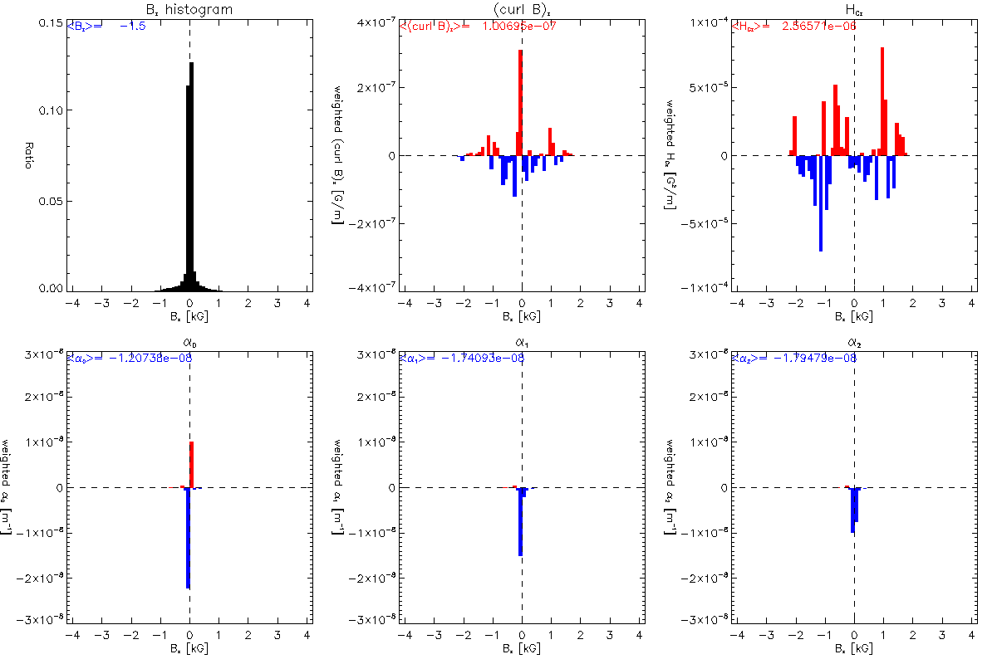
Local distribution of helical parameters over a magnetogram (20070930_130004) with FF
Revised

Slide 40
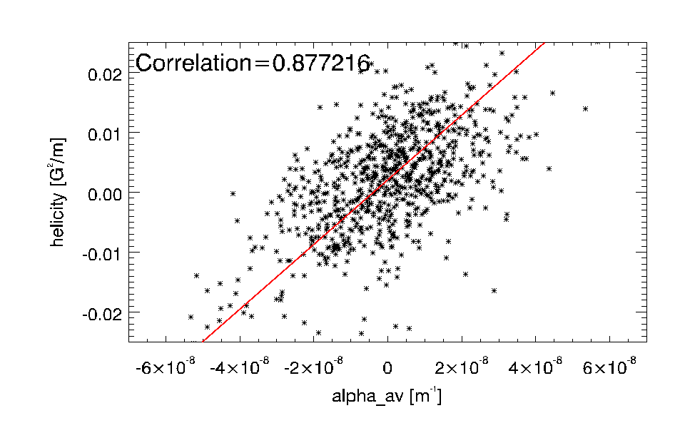
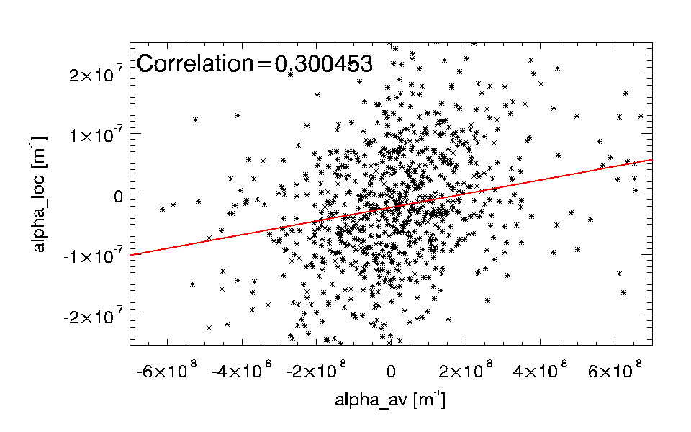
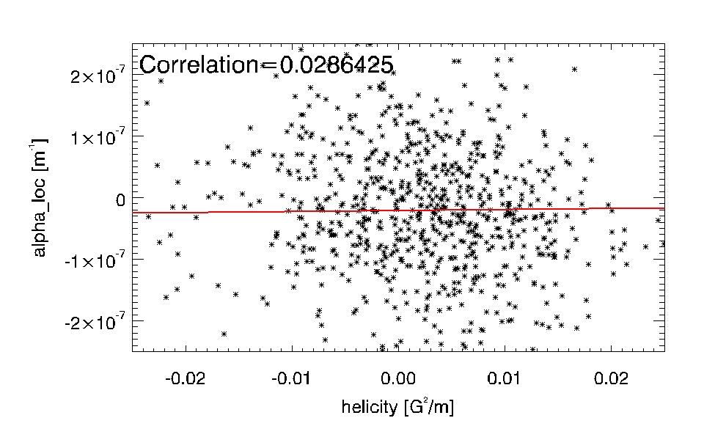



Statistical relations between three helical parameters-1
Plotting for all 864 magnetograms
$${α_{}^{(0)}}_{loc}$$
$${α_{}^{(1)}}_{av}$$
$${α_{}^{(1)}}_{av}$$
Low correlation for overall range of data
$${α_{}^{(0)}}_{loc}$$

Slide 41
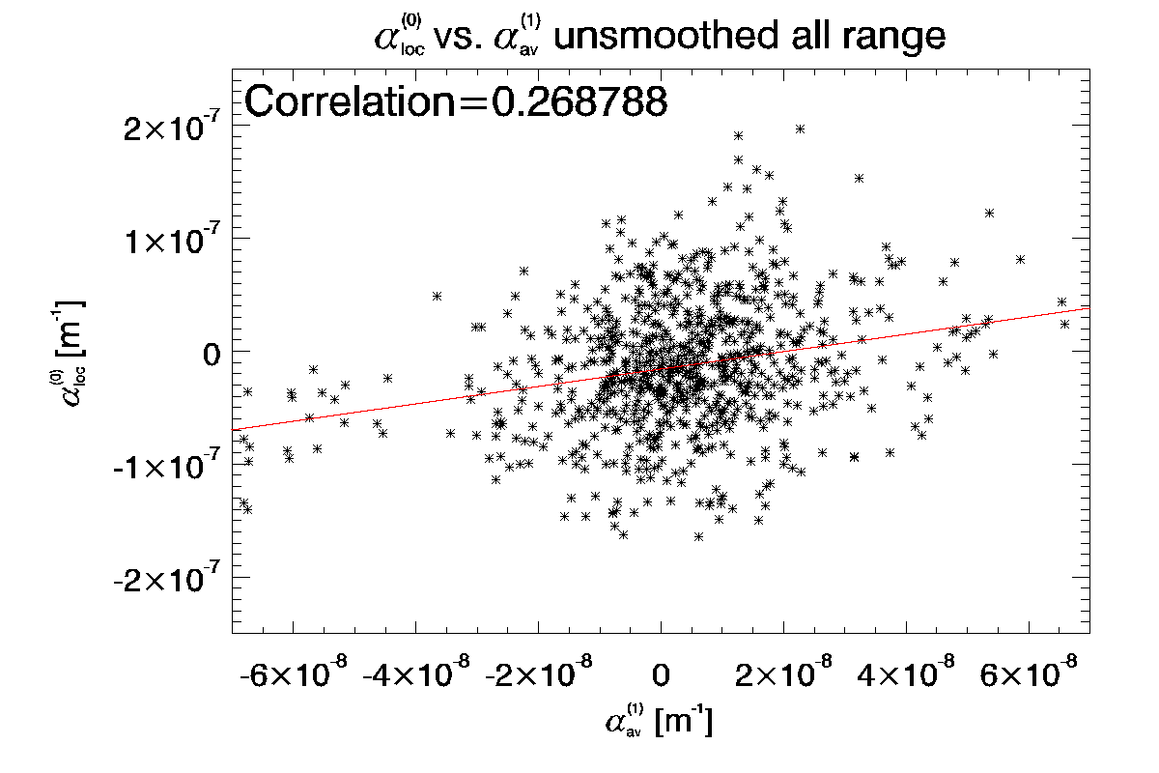
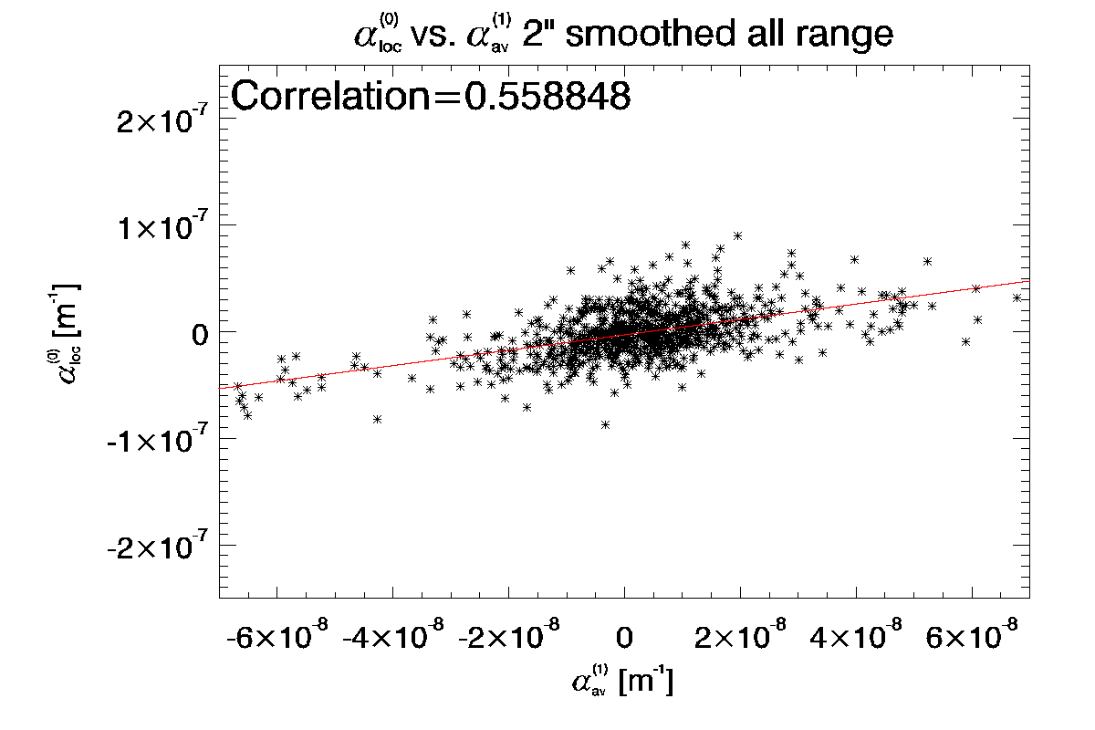
Statistical relations between three helical parameters-1

Slide 42
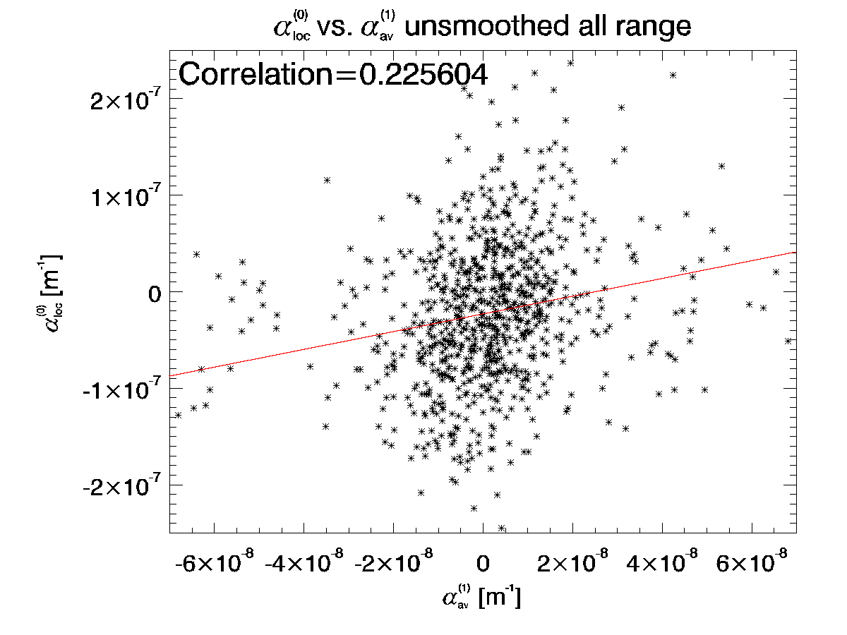
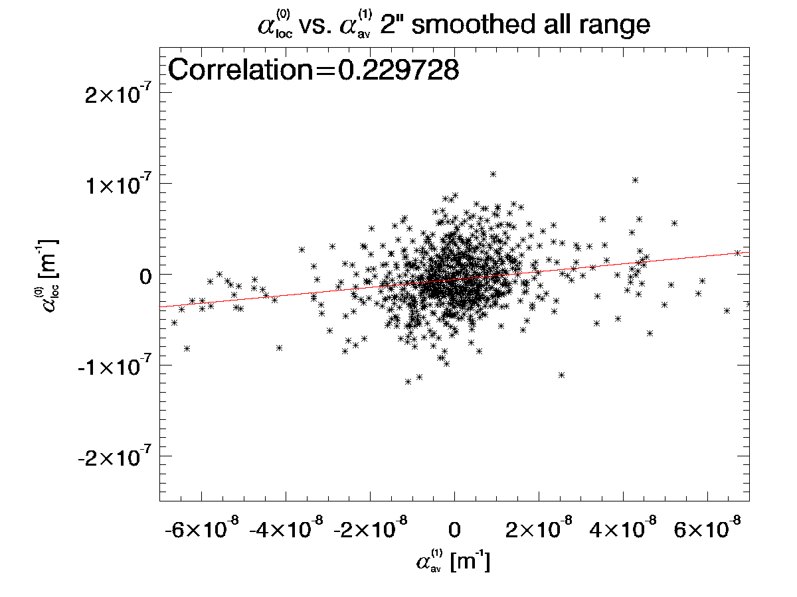
Statistical relations between three helical parameters-1
Revised

Slide 43
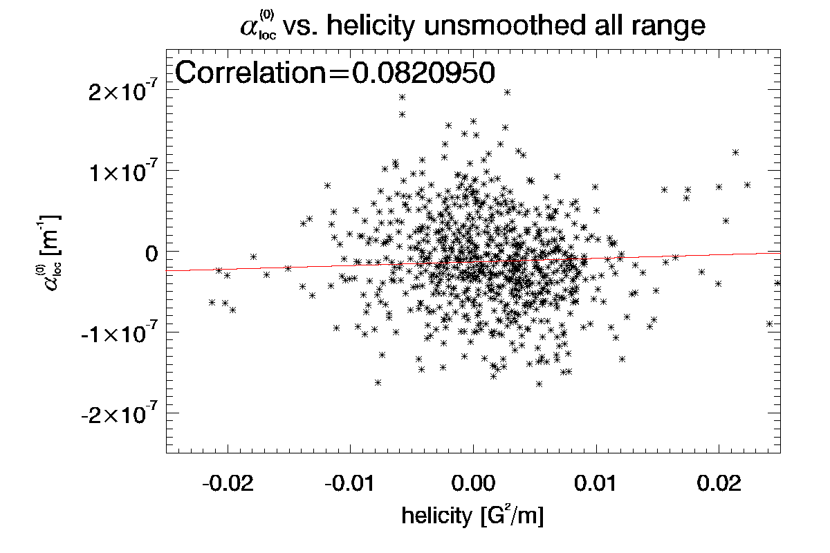
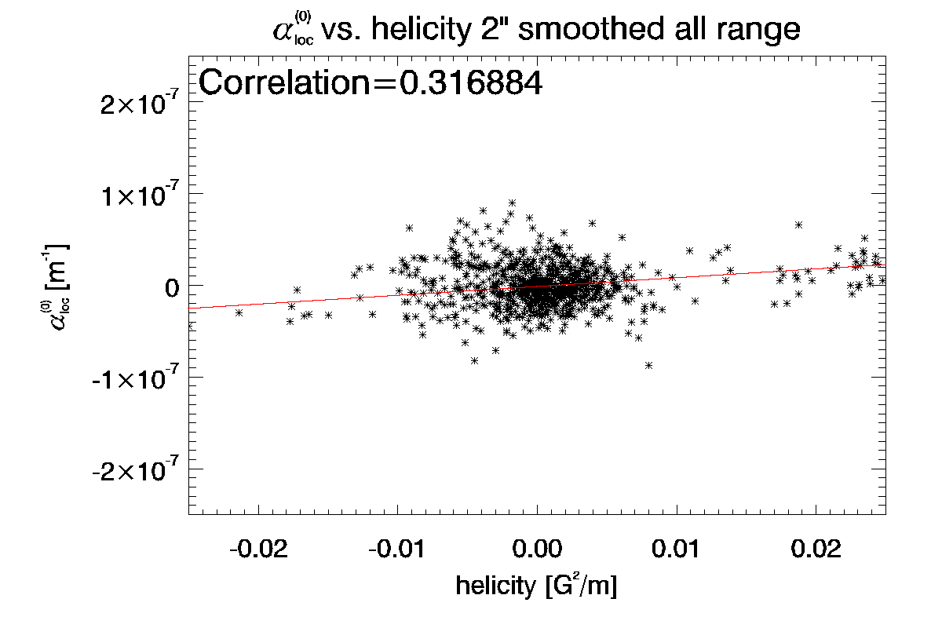
Statistical relations between three helical parameters-2
Low correlation for overall range of data

Slide 44
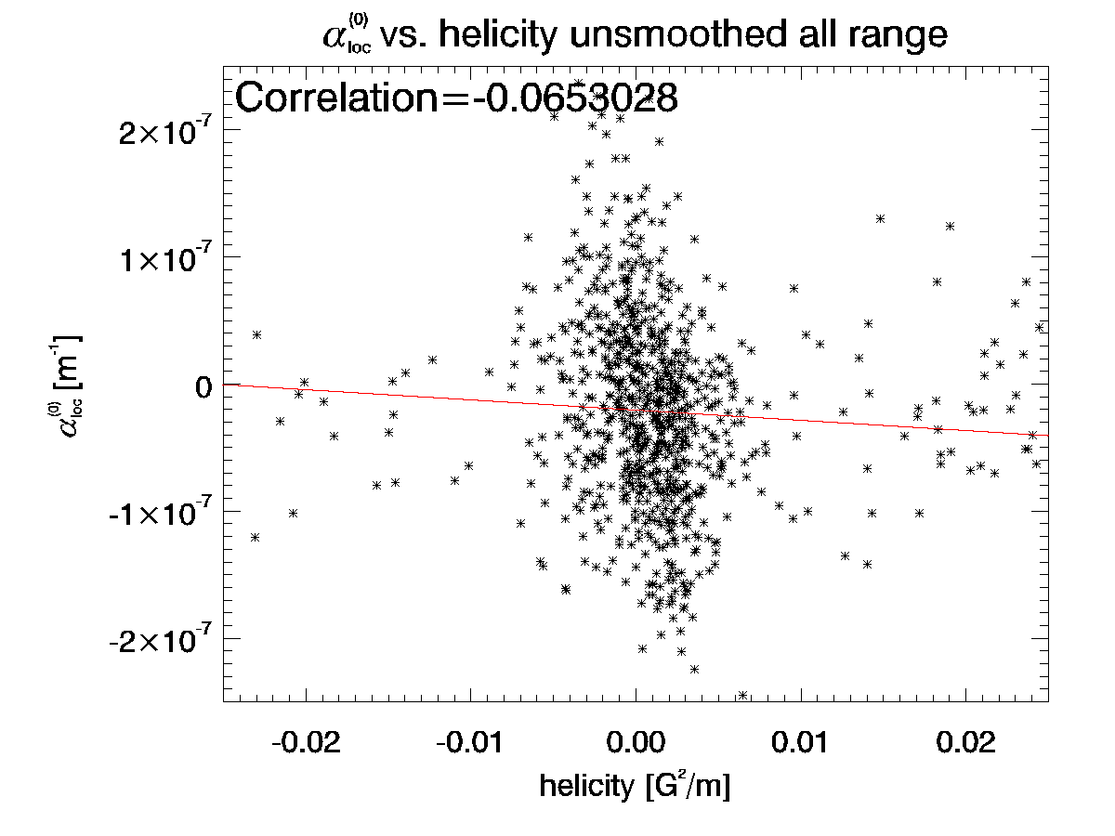
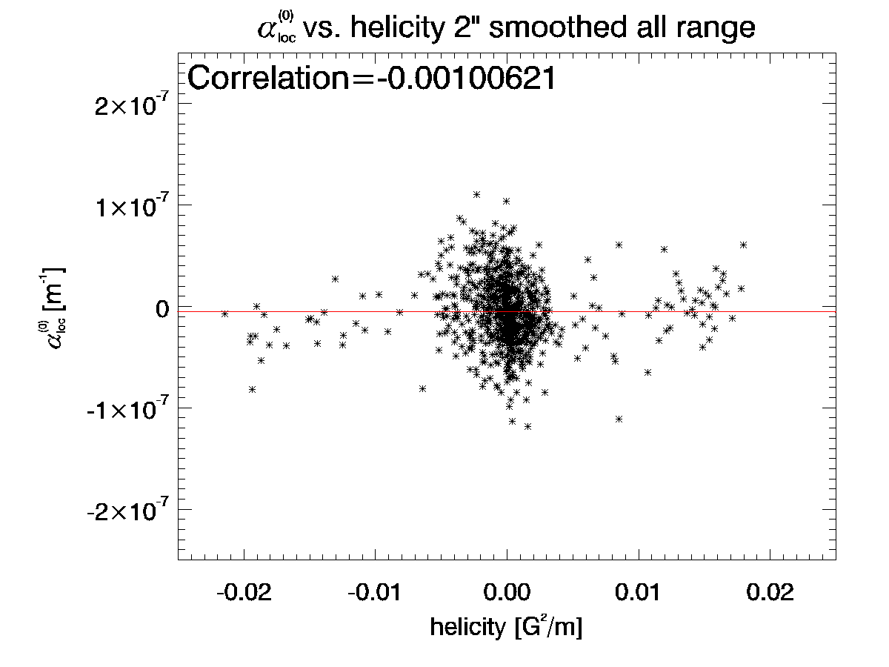
Statistical relations between three helical parameters-2
Revised
Low correlation for overall range of data

Slide 45
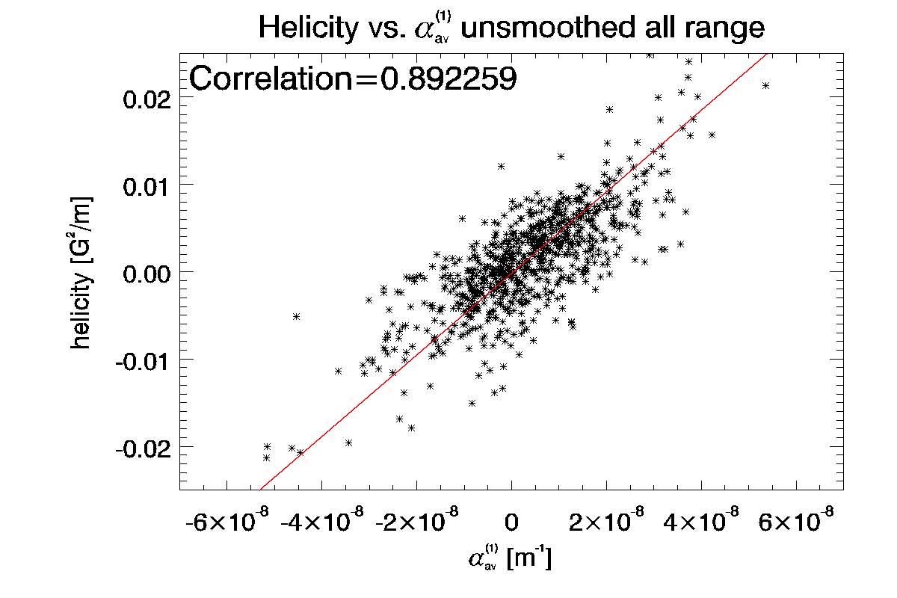
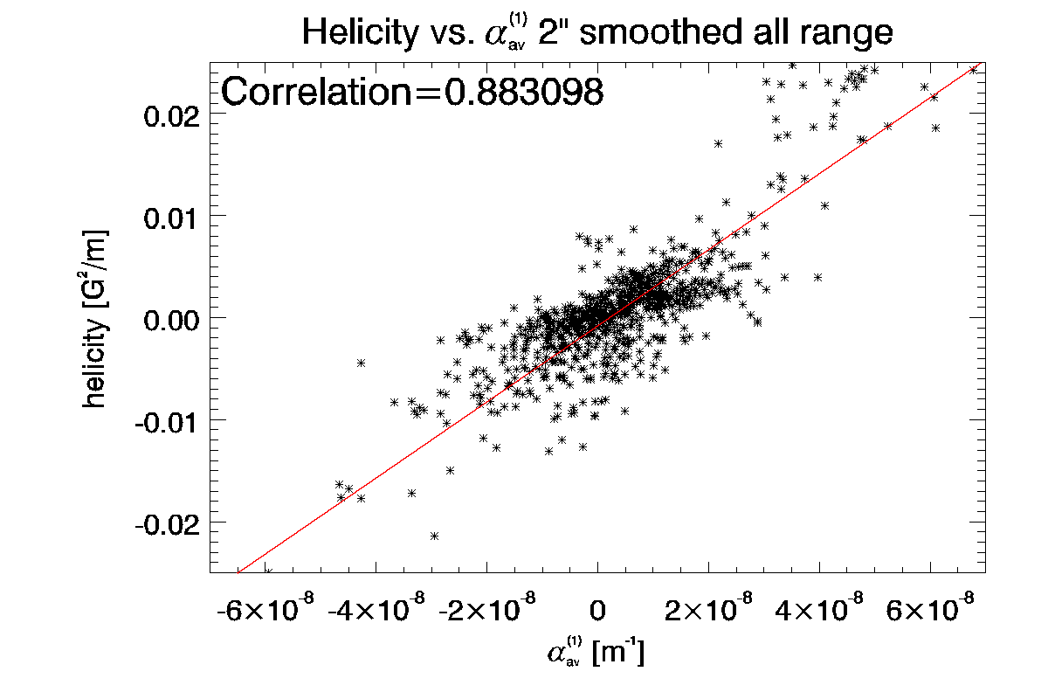
Statistical relations between three helical parameters-3

Slide 46
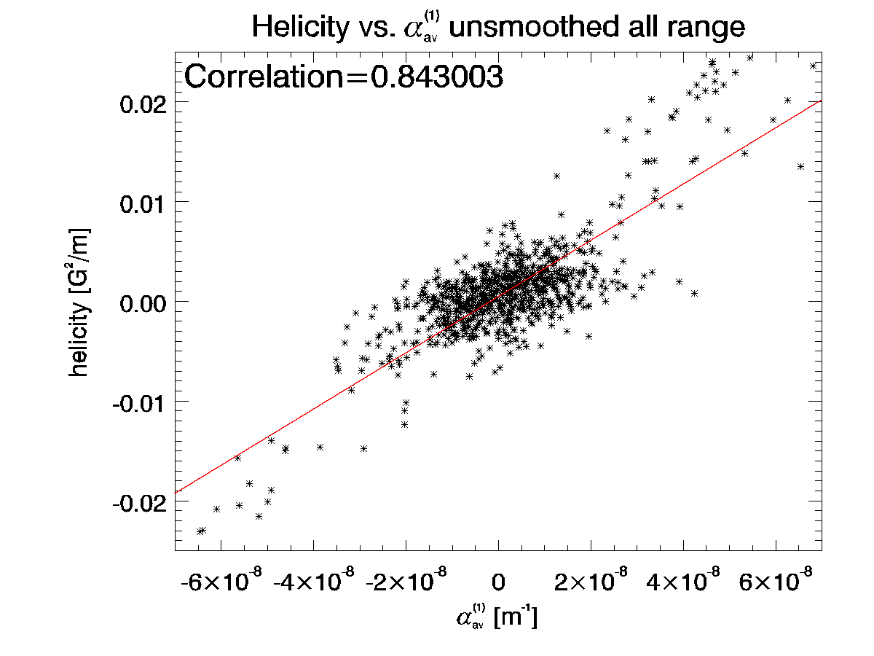
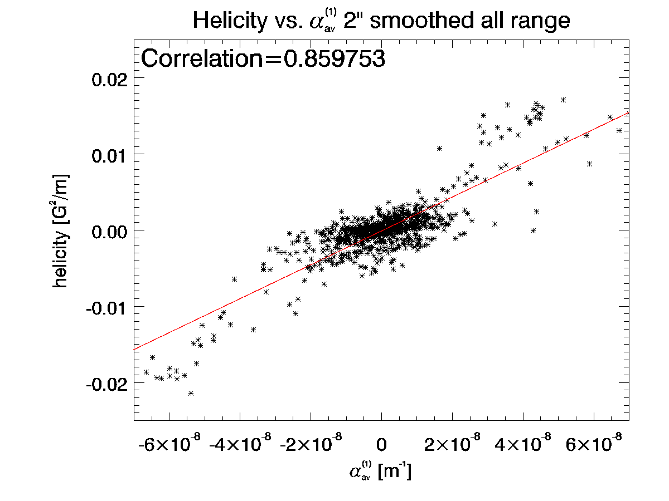
Statistical relations between three helical parameters-3
Revised

Slide 47
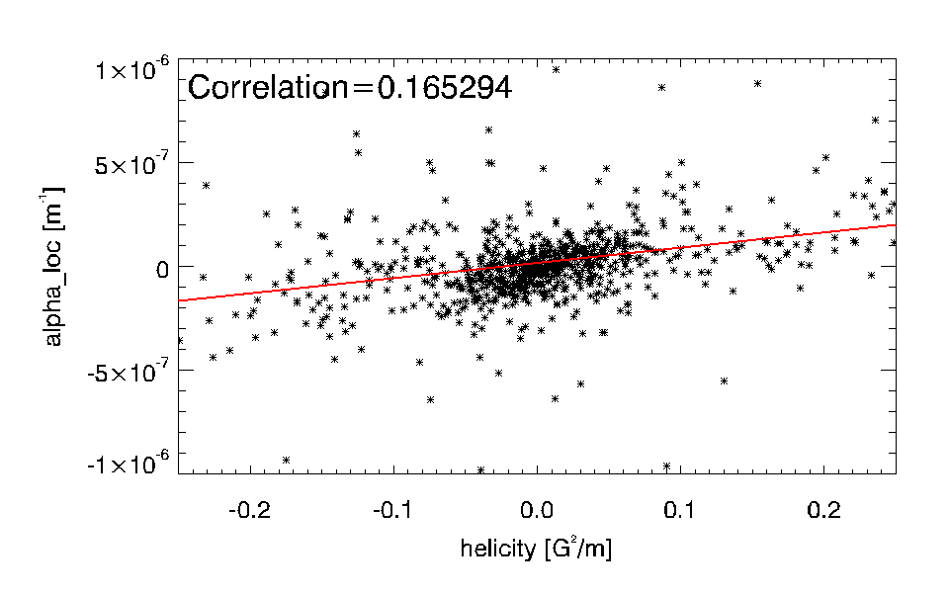
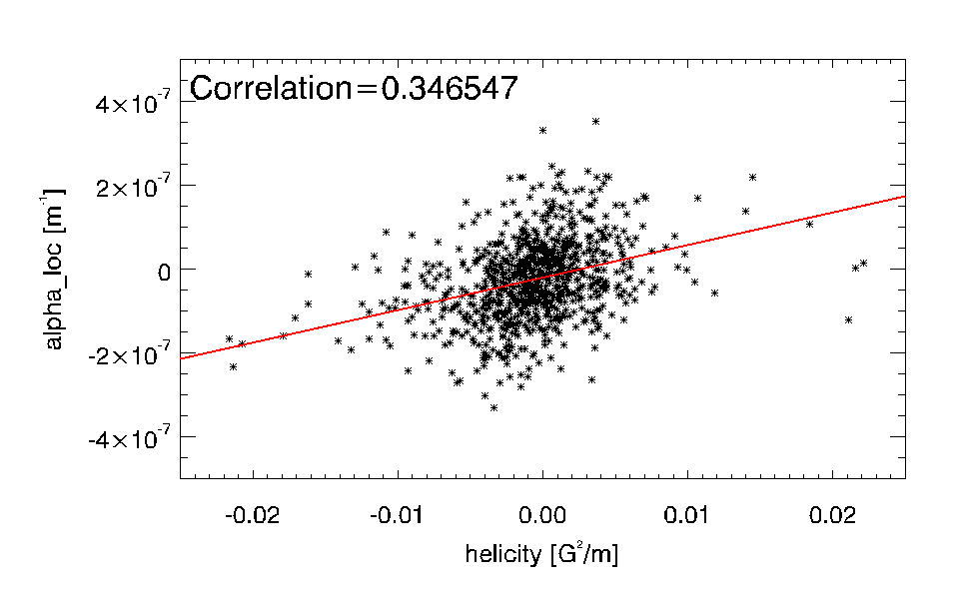
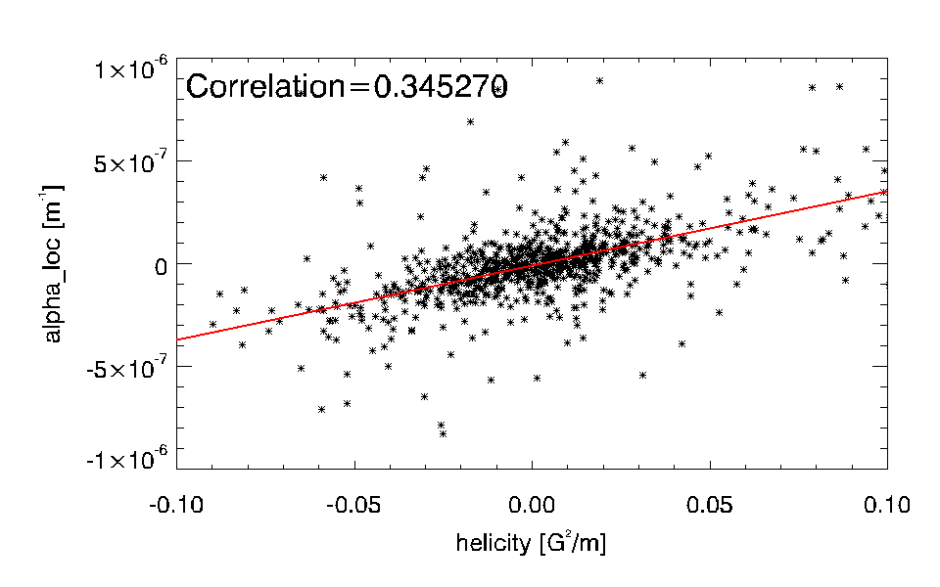


Statistical relations between three helical parameters-2
Plotting for all 864 magnetograms
$${α_{}^{(0)}}_{loc}$$
$${α_{}^{(0)}}_{loc}$$
smoothed by 2 arcsec Gaussian filter
vertical field range 10G<|B|<1kG
both vertical field range 10G<|B|<1kG and
smoothed by 2 arcsec Gaussian filter
$${α_{}^{(0)}}_{loc}$$

Slide 48
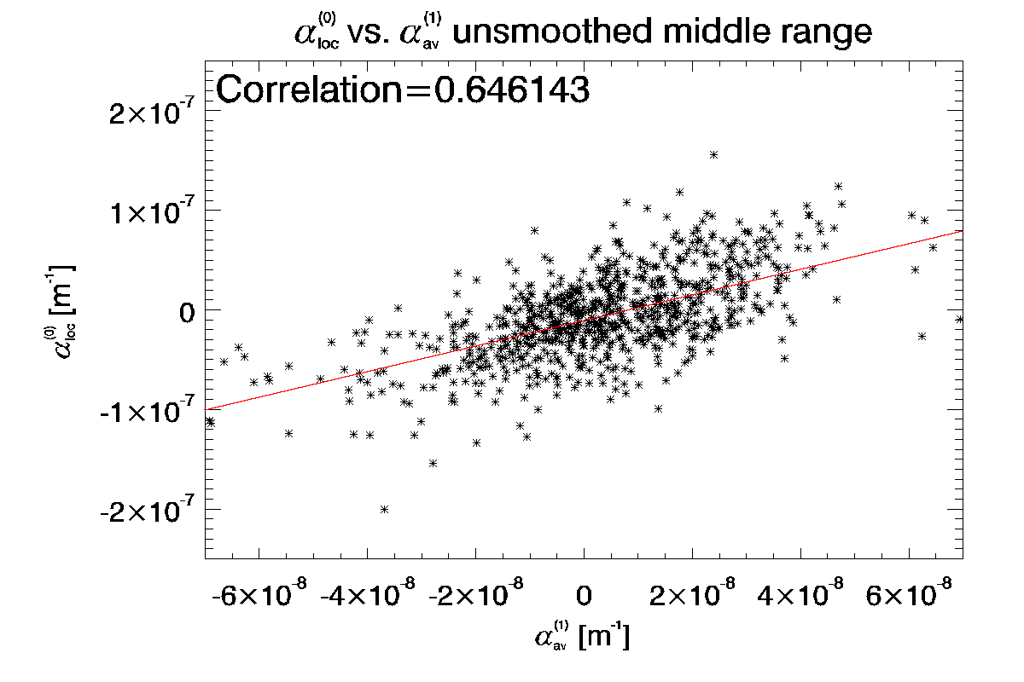
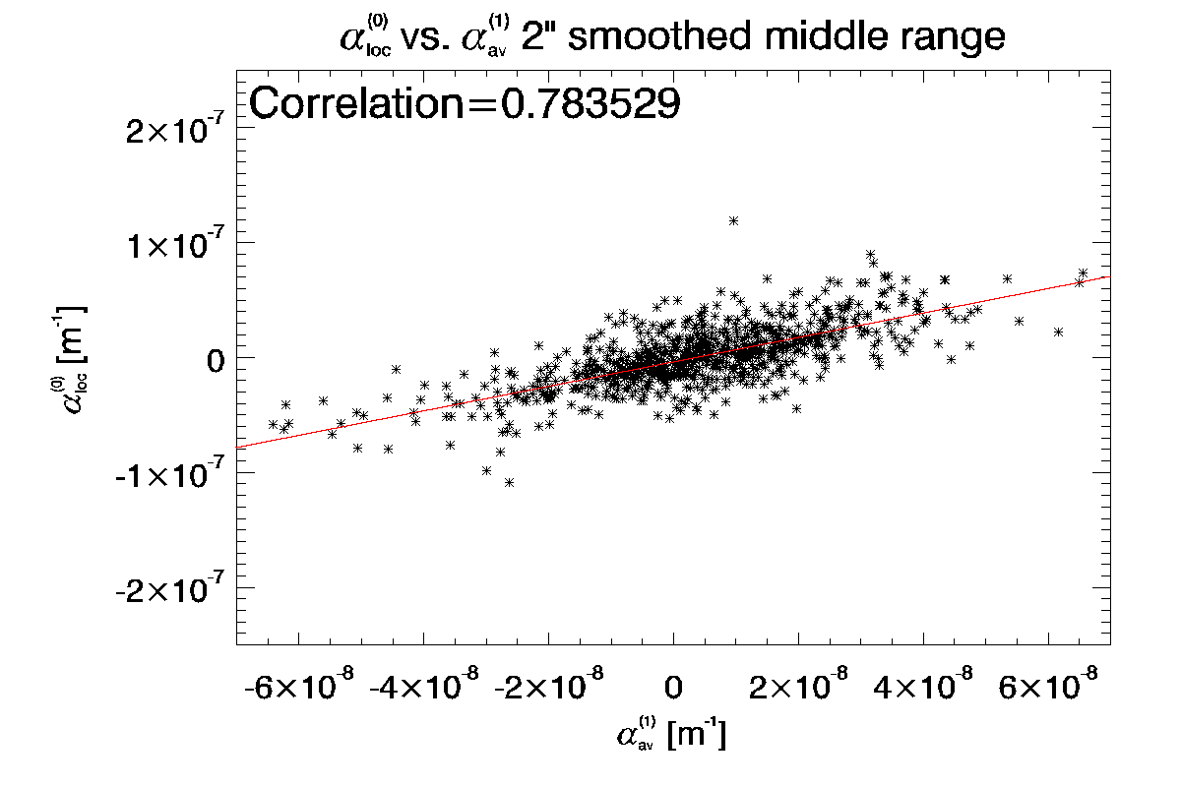
Statistical relations between three helical parameters-4

Slide 49
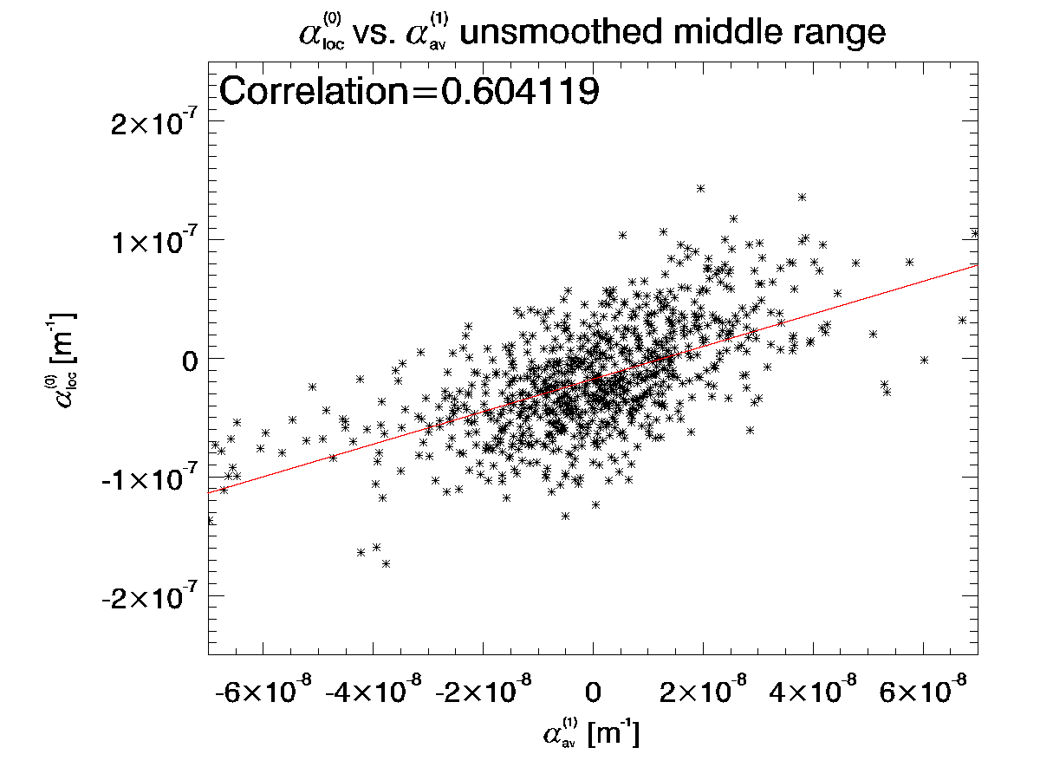
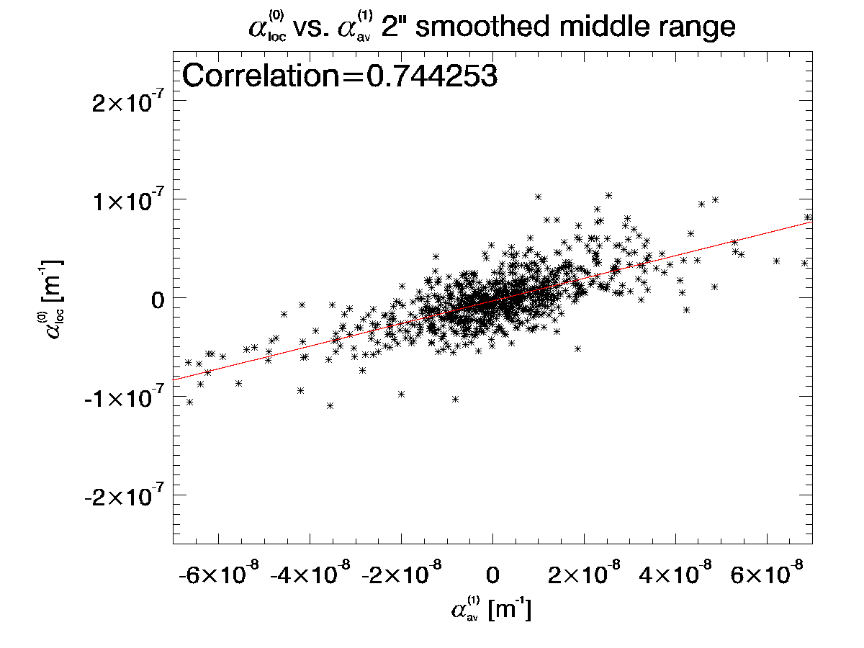
Statistical relations between three helical parameters-4
Revised

Slide 50
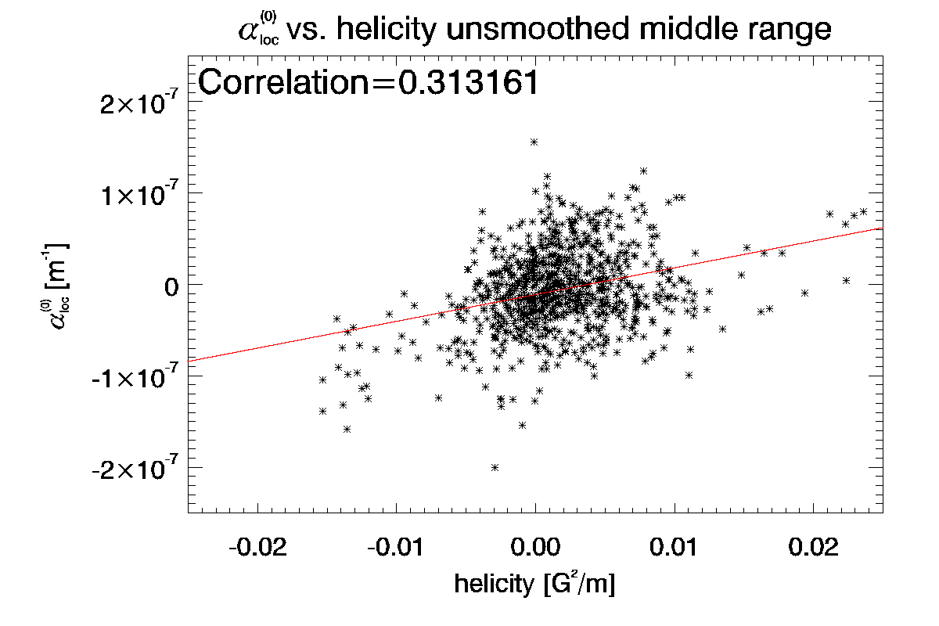
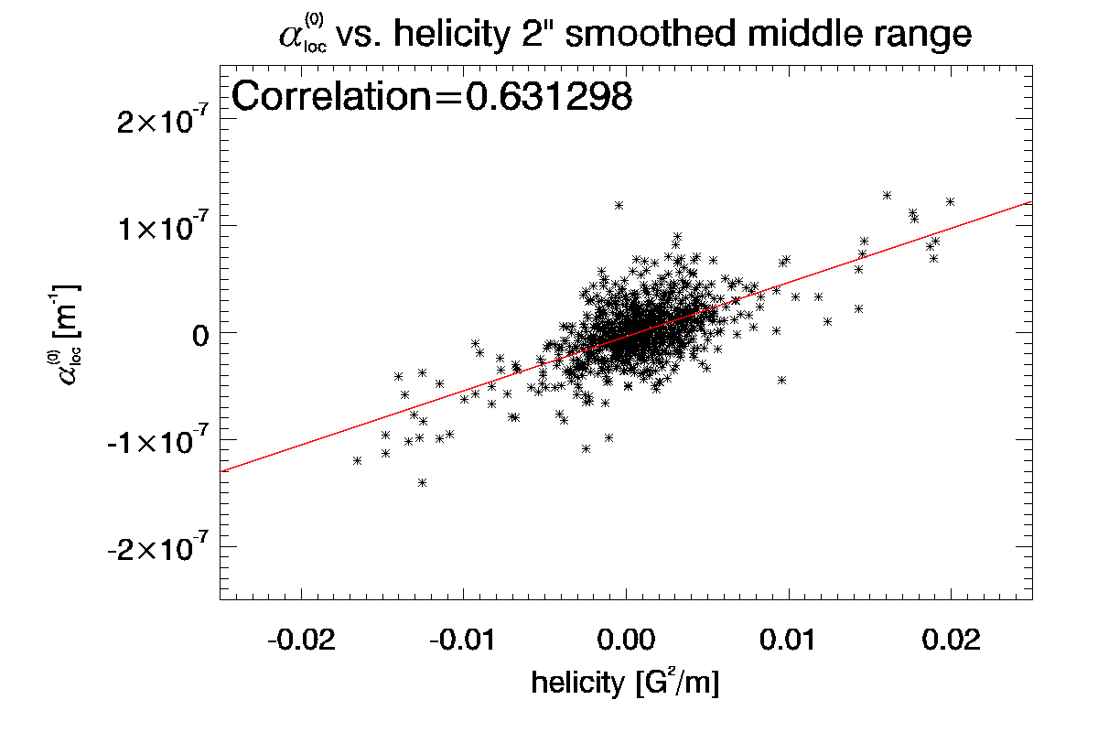
Statistical relations between three helical parameters-5
Better correlation for middle range of data

Slide 51


Statistical relations between three helical parameters-5
Revised
Better correlation for middle range of data

Slide 52


Statistical relations between three helical parameters-6

Slide 53


Statistical relations between three helical parameters-6
Revised

Slide 54
Grouping and averaging data
Choice 1: by active region (102 ARs) – data may occur statistically correlated
Choice 2: by bins in time and latitude (>30 magnetograms in each bin), 18 bins !
Assuming statistical independence,
95% Student’s confidence interval computed

Slide 55


Butterfly diagram of H_{Cz}
$$H_{Cz}={\text{(}\text{Curl} B\text{)}}_{z}×B_{z}$$
Middle-range fields
(10G<Bz<1000G)
Strong fields
(Bz>1000G)

Slide 56

Butterfly diagram of H_{Cz}
$$H_{Cz}={\text{(}\text{Curl} B\text{)}}_{z}×B_{z}$$
Middle-range fields
(10G<Bz<1000G)
Strong fields
(Bz>1000G)

Slide 57

Butterfly diagram of H_{Cz}
Revised
$$H_{Cz}={\text{(}\text{Curl} B\text{)}}_{z}×B_{z}$$
Middle-range fields
(10G<Bz<1000G)
Strong fields
(Bz>1000G)

Slide 58



Butterfly diagram of $α_{loc}$
  $${α_{}^{(0)}}_{loc}=\left\langle {\text{(}\text{Curl} B\text{)}}_{z}/B_{z}\right\rangle$$
Middle-range fields
(10G<Bz<1000G)
Strong fields
(Bz>1000G)

Slide 59

Butterfly diagram of $α_{loc}$
  $${α_{}^{(0)}}_{loc}=\left\langle {\text{(}\text{Curl} B\text{)}}_{z}/B_{z}\right\rangle$$
Middle-range fields
(10G<Bz<1000G)
Strong fields
(Bz>1000G)

Slide 60

Butterfly diagram of $α_{loc}$
Revised
  $${α_{}^{(0)}}_{loc}=\left\langle {\text{(}\text{Curl} B\text{)}}_{z}/B_{z}\right\rangle$$
Middle-range fields
(10G<Bz<1000G)
Strong fields
(Bz>1000G)

Slide 61



Butterfly diagram of $α_{av}$
$${α_{}^{(1)}}_{av}=\left\langle {\text{(}\text{Curl} B\text{)}}_{z}∙\text{sign}\left(B_{z}\right)\right\rangle /\left\langle \left|B_{z}\right|\right\rangle$$
Middle-range fields
(10G<Bz<1000G)
Strong fields
(Bz>1000G)

Slide 62

Butterfly diagram of $α_{av}$
$${α_{}^{(1)}}_{av}=\left\langle {\text{(}\text{Curl} B\text{)}}_{z}∙\text{sign}\left(B_{z}\right)\right\rangle /\left\langle \left|B_{z}\right|\right\rangle$$
Middle-range fields
(10G<Bz<1000G)
Strong fields
(Bz>1000G)

Slide 63

Butterfly diagram of $α_{av}$
Revised
$${α_{}^{(1)}}_{av}=\left\langle {\text{(}\text{Curl} B\text{)}}_{z}∙\text{sign}\left(B_{z}\right)\right\rangle /\left\langle \left|B_{z}\right|\right\rangle$$
Middle-range fields
(10G<Bz<1000G)
Strong fields
(Bz>1000G)

Slide 64

Scatter plot: Hcz_{middle} vs. Hcz_{strong}
Fitted line (all data) correlation=+0.28
Fitted line (inside box) correlation=-0.27

Slide 65

Scatter plot: Hcz_{middle} vs. Hcz_{strong}
Revised

Slide 66

Scatter plot $α_{loc }$_{middle} vs. $α_{loc}$_{strong}
Fitted line (all data) correlation=-0.24
Fitted line (all data)
Fitted line (inside box)

Slide 67

Scatter plot $α_{loc }$_{middle} vs. $α_{loc}$_{strong}

Slide 68

Scatter plot $α_{loc }$_{middle} vs. $α_{loc}$_{strong}
Revised

Slide 69


Scatter plot $α_{av}$_{middle} vs. $α_{av}$_{strong}
Fitted line (all data) correlation=-0.06
Fitted line (inside box) correlation=-0.54

Slide 70

Scatter plot $α_{av}$_{middle} vs. $α_{av}$_{strong}

Slide 71

Scatter plot $α_{av}$_{middle} vs. $α_{av}$_{strong}
Revised

Slide 72


Scatter plot $α_{gl}$_{middle} vs. $α_{gl}$_{strong}

Slide 73

Scatter plot $α_{gl}$_{middle} vs. $α_{gl}$_{strong}
Revised

Slide 74
Impact of strong fields
We found significant impact of strong fields to the hemispheric rules:
While middle-range fields generally produce the same hemispheric rule as established in ground based data, the strong fields contribute to the opposite sign of helical parameters.
Interpretation still remains (possible effect of buoyancy – fast rise of flux tubes; different depths of anchoring, cf. Kuzanyan et al. 2003; or effect of formation of an active region)

Slide 75
Hemispheric rule statistics
Carrington rotation number
Latitude (deg)
Time

Slide 76
Smoothed/unsmoothed data?
?

Slide 77

Compare:
Qualitatively, the both helical quantities are distributed in similarly
(after Zhang et al. 2010)

Slide 78



Simulating ground based data: middle-range fields (10G<|Bz|<1000G, Bt>150G) smoothed by 2” Gaussian filter
Hcz_{middle smoothed}
$α_{av}$_{middle smoothed}

Slide 79


Simulating ground based data: middle-range fields (10G<|Bz|<1000G, Bt>150G) smoothed by 2” Gaussian filter
Hcz_{middle smoothed}
$α_{av}$_{middle smoothed}

Slide 80
Let’s compare!

Slide 81
Let’s compare!

Slide 82
Conclusions
Developed systematic approach to studies of cycle variations of helical parameters with Hinode data
Extension of Zhang et al 2010 results up to 2006-2012 using Hinode data.
Found significant impact of strong fields to the hemispheric rules (Possible interpretation: buyancy->fast rising of flux tubes; or different depths of anchoring, cf. Kuzanyan et al. 2003).
Impact of sub-granular and intra-network scales to the helical parameters (Hcz and alpha) by smoothing over 2” scales has not been noted

Slide 83
Future plans
Account of projection effects;
Account of cross-correlations between consequent magnetograms of the same active region to reveal statistical behavior with time;
c) Study of helicity in quiet regions (much more data available)

Slide 84
        Thank you!
        спасибо!
        ¡Gracias!
        谢谢 !
        ありがとう !

Slide 85

Evolution of helicity with life time of an active region, example-1
Include these graphics if we have time.

Slide 86

Evolution of helicity with life time of an active region, example-2
Include these graphics if we have time.

Slide 87

Evolution of helicity with life time of an active region, example-3
Include these graphics if we have time.

Slide 88
Helicity overlaid with butterfly diagram

Slide 89
Twist overlaid with butterfly diagram

Slide 90
Example of data selection 2006-2007
(all data, FOV match, Strong Field, FF)

Slide 91
2007

Slide 92
2008

Slide 93
2009

Slide 94
2010

Slide 95
2011

Slide 96

Example of unreliable data
Filling
factor
B₀
Inclination
Azimuth

Slide 97

The role of helicity in dynamo
Magnetic helicity
inviscid invariant in MHD
Current helicity
observational proxy of magnetic helicity in solar active regions (Zhang et al. 2012)
signature of the alpha-effect (Seehafer 1994)

Slide 98
Schematic diagram of hybrid disambiguation method
Result 1 : B_{1x}, B_{0y}
Resize with 1” resolution
Potential field approximation
Disambiguated data by potential field method
Low resolution data
non-disambiguated data : B_{0x}, B_{0y}
NPFC code
Low resolution disambiguated data by NPFC method
Weak field (<300G)
Resize to original size
disambiguated data by NPFC method
(1” resolution)
disambiguated data using result 2 as the reference
Combination of result 1 and result 3 according to Bz field strength
use as a reference
Strong field (>300G)
Result 2: B_{2x}, B_{2y}
Result 3 : B_{3x}, B_{3y}
B_{4x}=B_{1x}(|B_{z}|<300), or B_{3x} (|B_{z}|>300)
B_{4y}=B_{1y}(|B_{z}|<300), or B_{3y} (|B_{z}|>300)

Slide 99

Example of accuracy of (curlB)z computation (201104_035016)

Slide 100

Butterfly diagram of H_{Cz}
$$H_{Cz}={\text{(}\text{Curl} B\text{)}}_{z}×B_{z}$$
Middle-range fields
(10G<Bz<1000G)
Strong fields
(Bz>1000G)

Slide 101

Butterfly diagram of $α_{loc}$
  $${α_{}^{(0)}}_{loc}=\left\langle {\text{(}\text{Curl} B\text{)}}_{z}/B_{z}\right\rangle$$
Middle-range fields
(10G<Bz<1000G)
Strong fields
(Bz>1000G)

Slide 102

Butterfly diagram of $α_{av}$
$${α_{}^{(1)}}_{av}=\left\langle {\text{(}\text{Curl} B\text{)}}_{z}∙\text{sign}\left(B_{z}\right)\right\rangle /\left\langle \left|B_{z}\right|\right\rangle$$
Middle-range fields
(10G<Bz<1000G)
Strong fields
(Bz>1000G)

