Slide 1
Solar Helical Magnetic Fields and Sound Waves in Sunspots
Kirill Kuzanyan
IZMIRAN, Troitsk, Moscow, Russia
Robert Sych
Institute for Solar Terrestrial Physics (ISZF SO RAN), Irkutsk, Russia
Shangbin Yang, Yihua Yan, and Sijie Yu
National Astronomical Observatory of China (NAOC), Beijing, China
Plasma2014,IKI, 2014-02-10

Slide 2
Motivation
Is there magnetic helicity above the solar photosphere....?
How can we justify boundary conditions for magnetic helicity flux in dynamo models?
How magnetic helicity expands through the corona into the entire heliosphere (solar wind)?

Slide 3
Helical nature of swirling sunspots
There is a long history of studies of sunspot rotation....

Slide 4
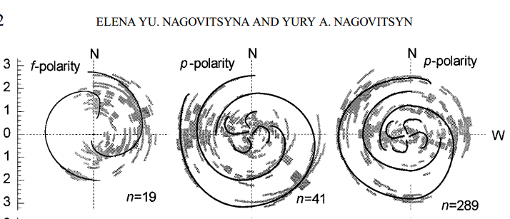
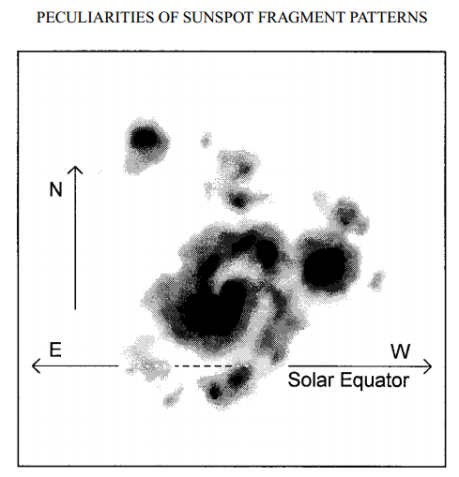
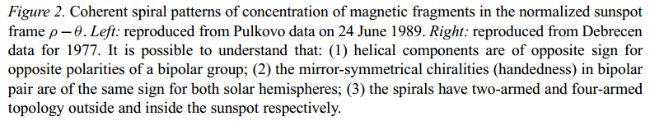
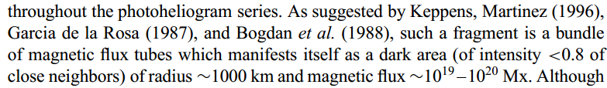
Spiral structures in photometry of sunspots
E. Yu. Nagovitsyna and
Yu.A. Nagovitsyn, Observations of peculiarities of sunspot fragment patterns
Solar Physics, 186, 1999

Slide 5
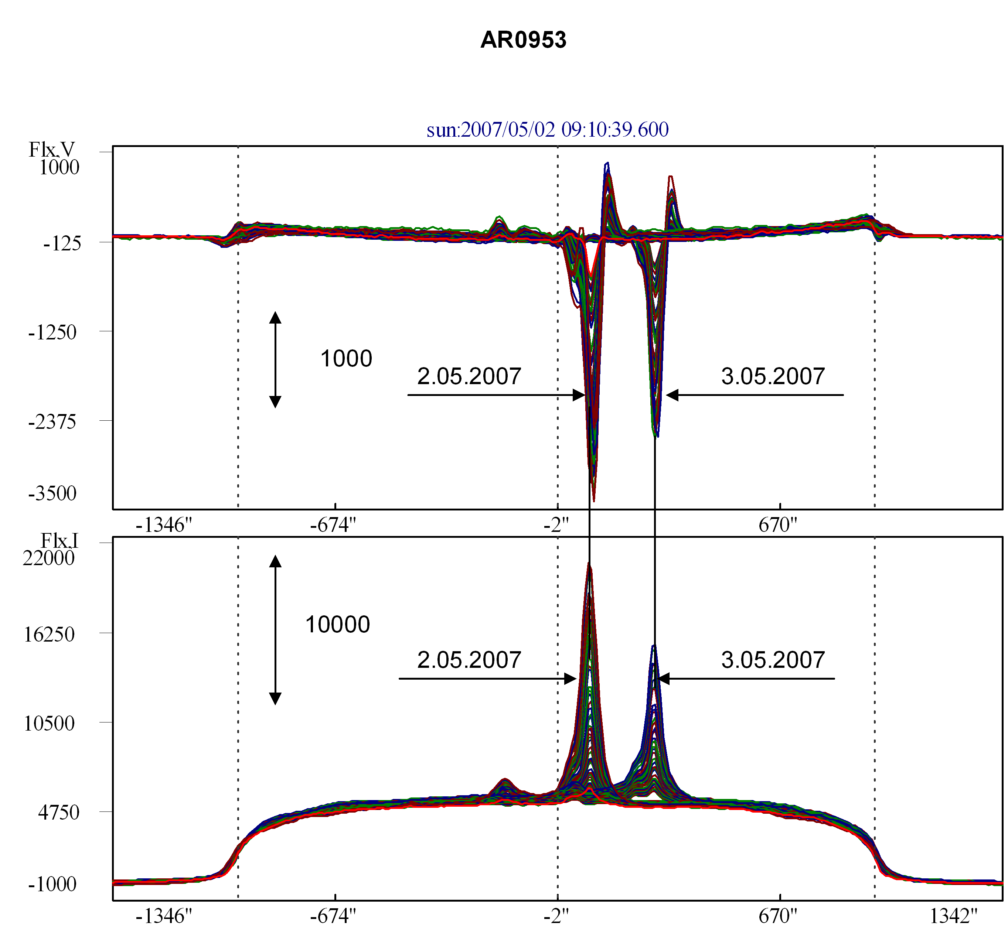
Expanding spirals of magnetic field above sunspots (RATAN-600, radioheliograph data)
Bodog, V., Stupishin, A., Yasnov, L. 2011: Исследование высотной структуры активной области с использованием многоволновых радио наблюдений, Богод В.М., Ступишин А.Г., Яснов Л.В., СПб Ф САО РАН, СПб ГУ, 2011

Slide 6
Observation of Superpenumbral Whirls & Subsurface Kinetic Helicity
NOAA11084: (Komm, Gosain & Pevtsov 2013)

Slide 7
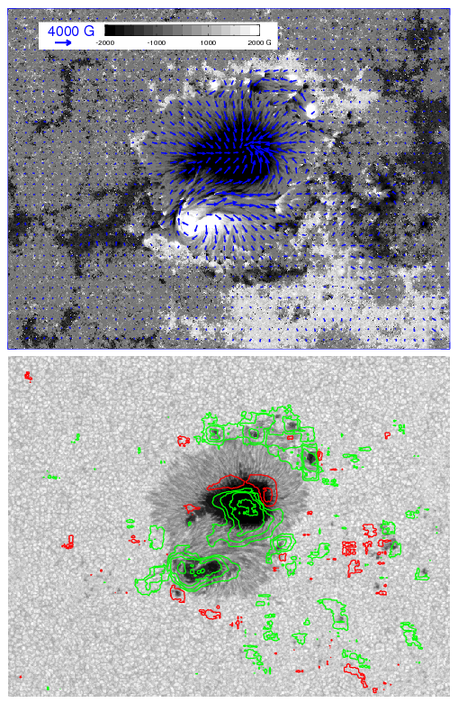

Studies of Current Helicity in Solar Active Regions: magnetic fields
(e.g. Zhang et al. 2010 & refs therein)
AR 10930 (SOT@Hinode)
2006 Dec 11 23:10:06 UT
Current Helicity:
positive/negative

Slide 8
AR NOAA6619 on 1991-5-11 @ 03:26UT (Huairou)
Photosphetic vector magnetogram
Current helicity over filtergram

Slide 9
Helical structures in magnetic field of solar active regions
Studies of current helicity distribution in the photosphere by vector magnetograms and studies of the rate of magnetic helicity flux from photospheric dynamics.
> The studies of helicity established the so-called hemispheric sign rule for helical parameters of solar magnetic field: the sign of helicity if NEGATIVE/POSITIVE in the NORTH/SOUTH hemispheres of the Sun; stable for several sunspot cycles but some detail vary with the phase of the cycle.

Slide 10
Methods used:
1. Pixel Wavelet Filtering analysis (PWF)
2. LCT (Local Correlation Tracking) applied to acoustic wave fronts, not the proper motion of the media

Slide 11
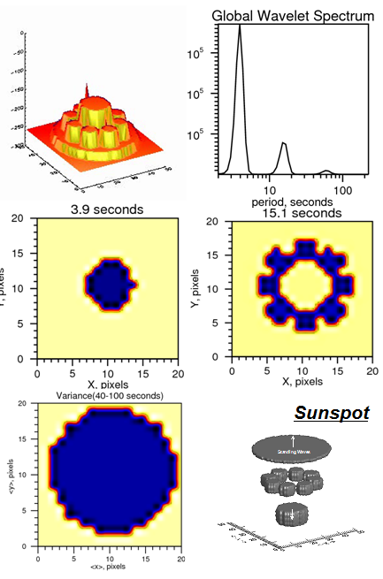
1. Pixel Wavelet Filtering (PWF), adopted from R. Sych
Time 1 C₁
Time 2 C₁
Time 3 C₁
3D TRACE Images cube
Variation Map
Freq. subband C_{N}
N1
N2
N3
Intensity N1
Wavelet Spectra
High freq.
Middle freq.
Low freq.
PWF (Pixel Wavelet Filtering)

Slide 12
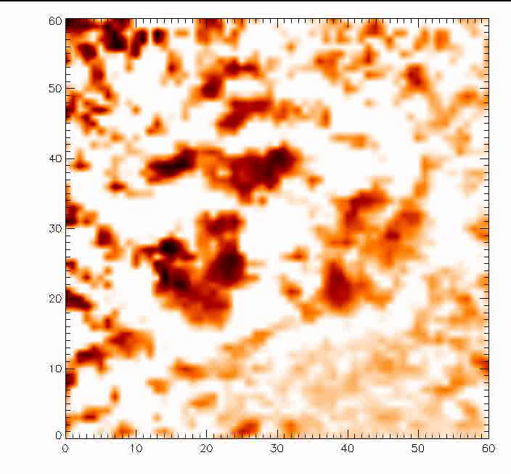
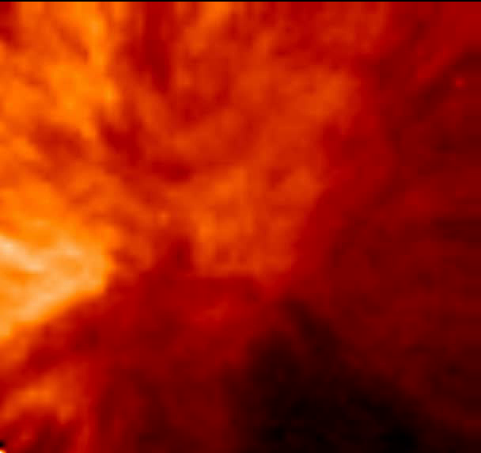
Wave front dynamucs above a sunspot
(SDO/AIA, 304A)
Original
Filtered
Application of PWF method developed
by Sych R., Nakariakov V., Solar Physics, 248, 2008

Slide 13
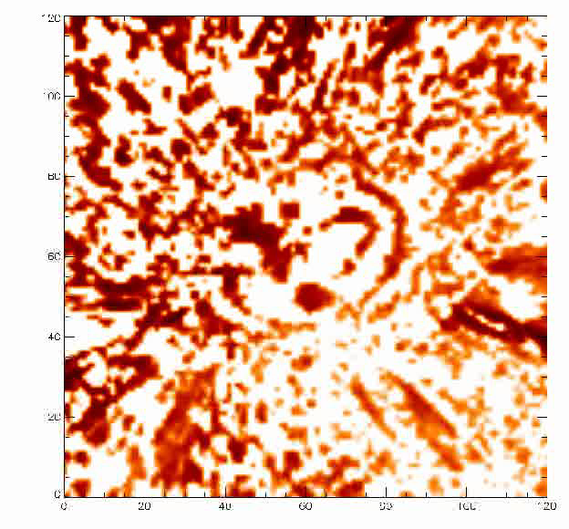
Filtered 304A

Slide 14
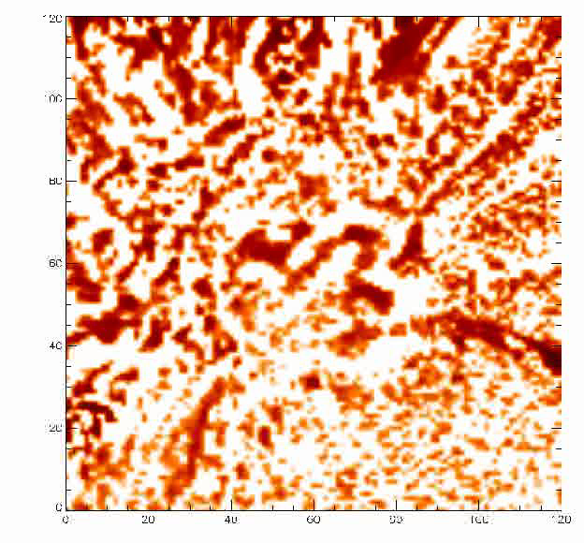
Filtered 171A

Slide 15
SDO/AIA high cadence data

Slide 16
Wave front phenomenology in the transition zone: chromosphere-corona
Chromosphere-corona transition (304А)
Corona (171А)

Slide 17
Spiral structures in various wavelength channels available from SDO/AIA (variety of temperatures/heights above the photosphere)

Slide 18
LCT (Local Correlation Tracking)
LCT central idea: proper motions (Δx,Δy) of intensity features in successive images separated in time by Δt, are found by maximizing a cross-correlation function,
or minimizing an error function between sub-regions of the images.
November & Simon (1988): shift images and compute a cross-correlation at each shift

Slide 19
LCT example mainly detection of proper motion
(Potts, Barrett & Diver, 2003)

Slide 20
Wave phase speed detection
Other Authors used LCT for detection of proper motion (velocity of media)
We suggest to use LCT on series of high cadence intensity images of sunspots to compute phase speed of MHD waves in sunspots
We may compute the horizontal part of phase vorticity (new quantity for analysis!)

Slide 21
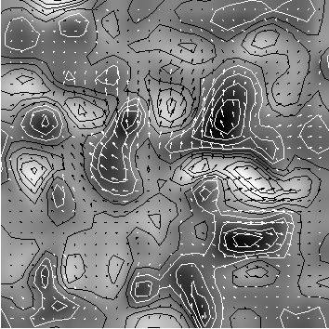
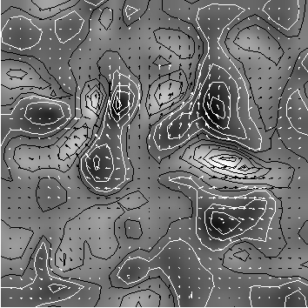
First results of LCT application: phase speed detection
λ=131A, t=99
λ=131A, t=100

Slide 22
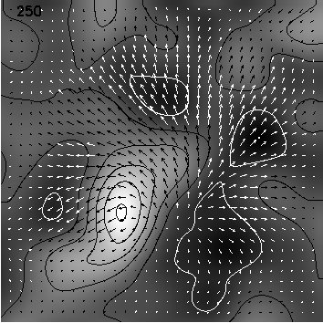
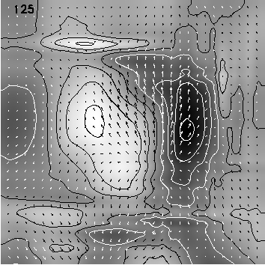
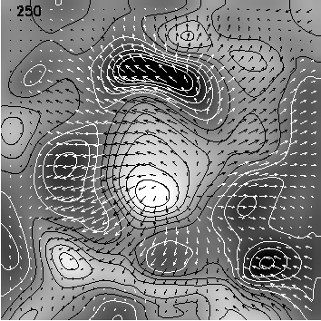
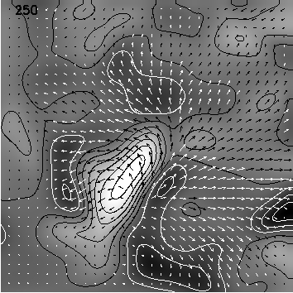
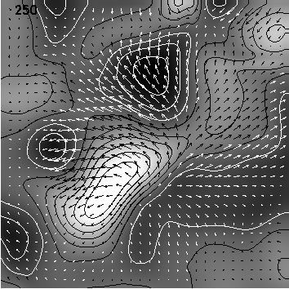
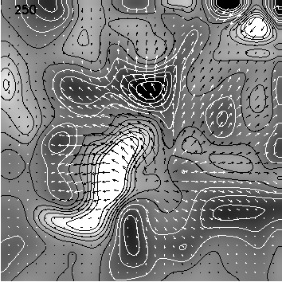
Snapshots
304
131
1700
171
211
194

Slide 23
movie…

Slide 24
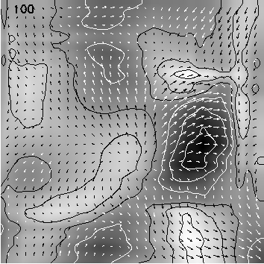
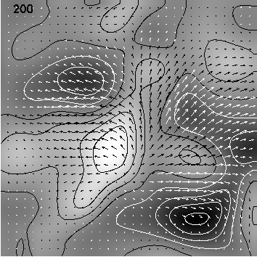
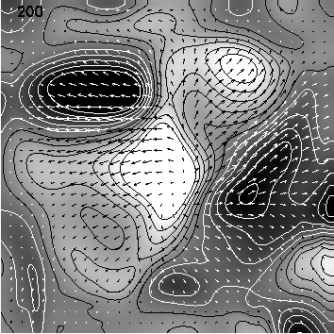
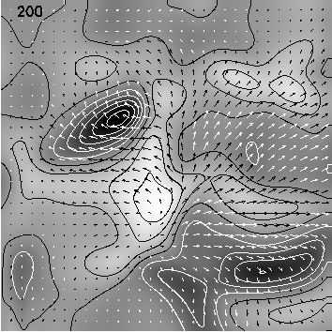
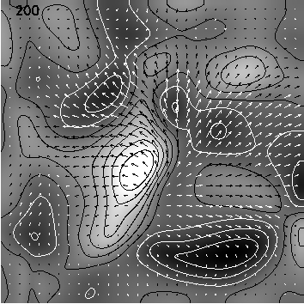
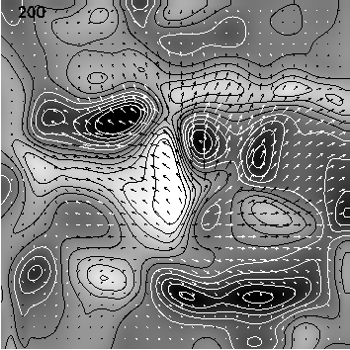
movie
304
131
1700
171
211
194

Slide 25
Where is magnetic helicity?
...this still remains for further investigation !...

Slide 26
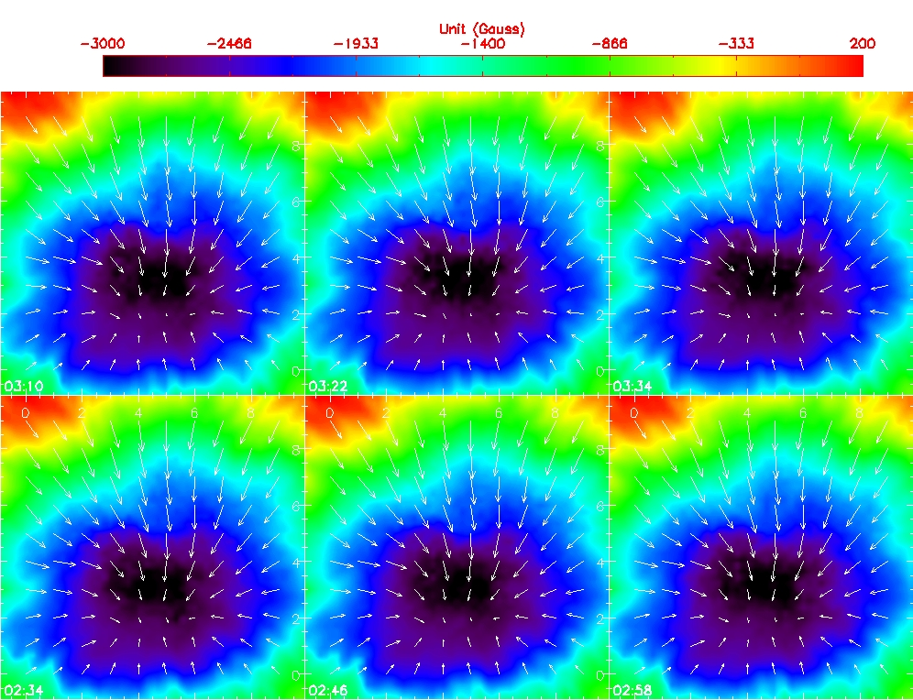
HMI vector magnetograms with 12 minute cadence

Slide 27
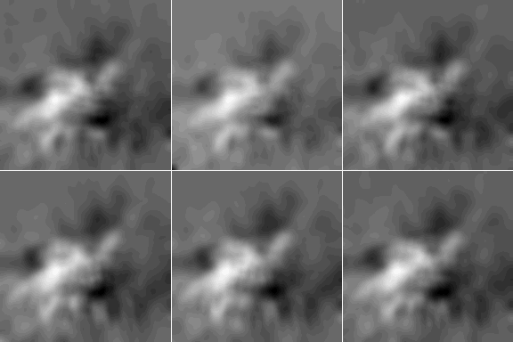
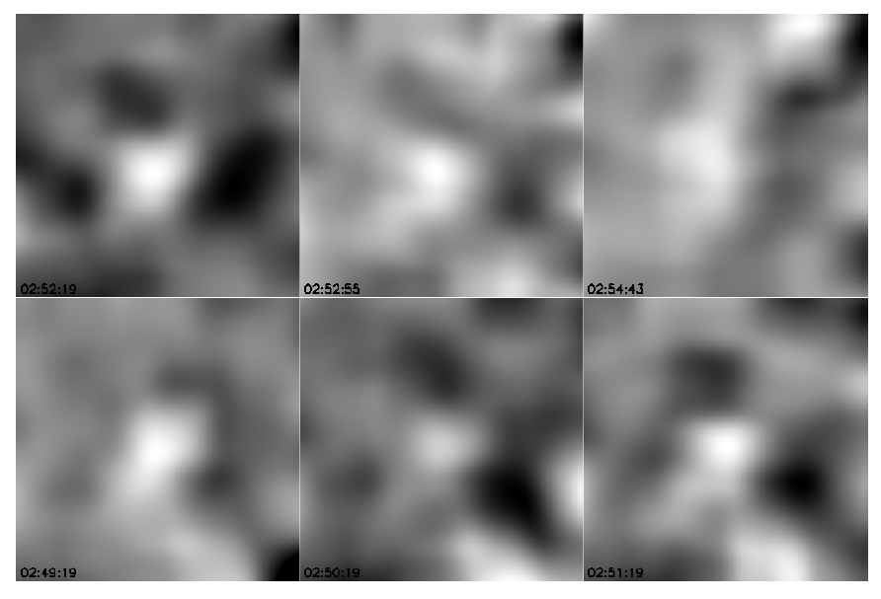
Confronting electric current
helicity and sound wave phase vorticity
NOAA11131
N31 W11
on 2010-12-08;
at 02:34:00 UT
HMI size 144x144 (0.5”)
AIA size 121x121 (0.6”)
[give values and greys-scales of vorticity & helicity]

Slide 28
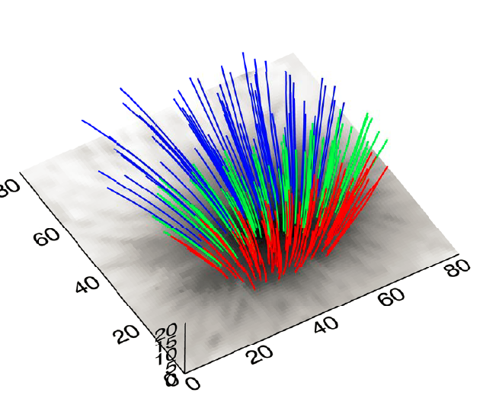
FOR FUTURE STUDIES:
Non-Linear Force Free (NLFF) extrapolation
(Calculated by Sijie YU)
Hc in different height 30Mm X 30Mm 03:34
1.1Mm 2.2Mm 3.3Mm

Slide 29
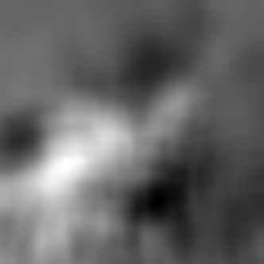
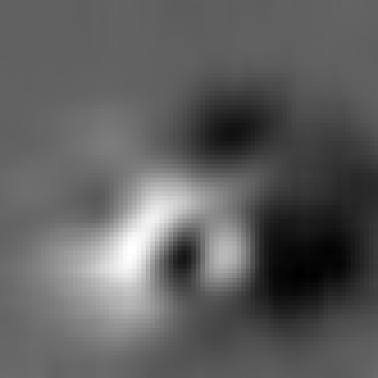
Comparison of helicities at different heights
Photosphere (z=0)
Chromosphere (z=1.1 Mm)

Slide 30
Conclusions
We found signatures of relationship between phase vorticity of MHD waves in sunspots and its magnetic field helical structure
The future target is detailed 3D dynamic description of sunspot swirling oscillations and shedding a light into the problem of helicity transfer from the solar interior to the heliosphere

Slide 31
Thank you!

